Slide 1
Word Crossword
Who ________
What ________
Pets ________
Have ________
Food ________
Like ________
Song ________
Make ________
Boy ________
love ________
Back ________
H | R | E | B | F | V | T | X
C | A | G | H | R | O | S | Y
Z | R | V | P | L | B | O | Y
D | O | E | E | H | E | N | D
W | H | A | T | Y | N | G | N
Y | L | O | V | E | C | K | R
B | A | C | K | M | A | K | E
U | L | I | K | E | N | N | C

Slide 2
Word Crossword
Is です
Who だれ
What 何
When いつ
Where どこ
Why なぜ
Can できる
Do する
Are それは
You あなた
Many 多くの
How どう やって

Slide 3
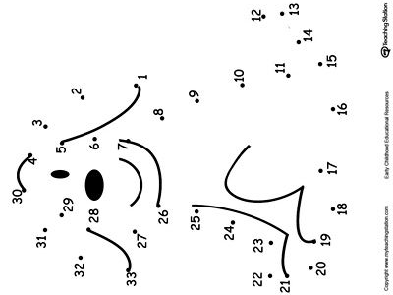

Slide 4
