Slide 1
DIRECTIONS

Slide 2
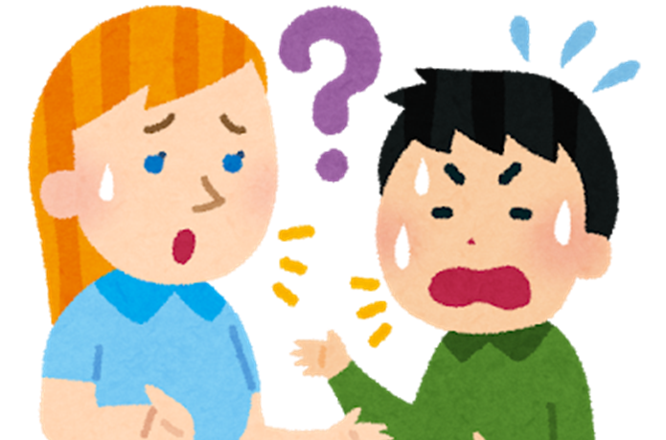
Where is the bus stop?

Slide 3
Go straight

Slide 4
Turn left

Slide 5
Turn right

Slide 6
Stop

Slide 7
U-turn

Slide 8
You can see it on your left

