Slide 1
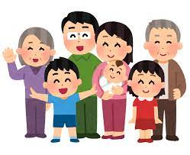
Family

Slide 2
father

Slide 3
mother

Slide 4
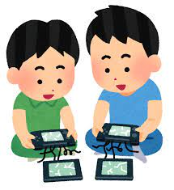
brother

Slide 5
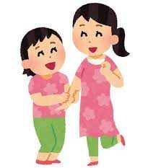
sister

Slide 6
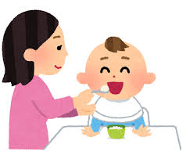
baby

Slide 7
grandpa

Slide 8
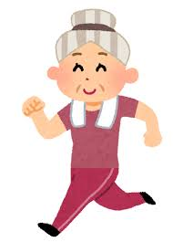
grandma

Slide 9
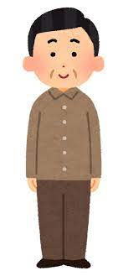
uncle

Slide 10
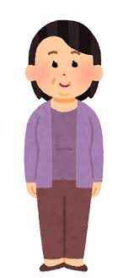
aunt

Slide 11
cousin

Slide 12
friend

