Slide 1
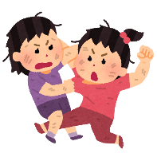
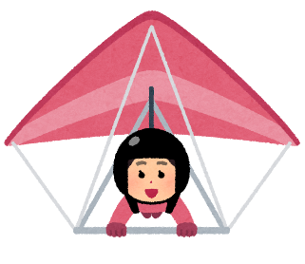
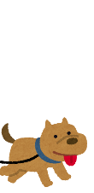
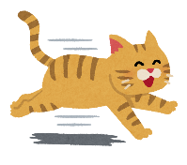
Alice and Yoko like music.
Yoko is wearing headphones.
Hugh is number ten.
Gordon knows Hugh.
Hiroshi has a pet.
Poochi knows Hiroshi.
Mary doesn’t like Linda.
Mary is wearing shorts (半ズボン).
Name:____________ Class:__-__ Number:___ Date:___________ Program 9
What are they doing?
Hints
Part 1
Jennifer and Mike can run fast.
Mark likes books.
Roy is wearing a cap.
Roy is not wearing shoes.
Ken is tall, and he is playing rugby.
Ken knows Bill.
Sara likes bread, and she is late.
Tiger is cute, and she has a tail (尻尾).
Alice:__ Yoko:__ Hugh:__ Gordon:__ Hiroshi:__ Poochi:__ Mary:__ Linda:__
Jennifer:__ Mike:__ Mark:__ Roy:__ Ken:__ Bill:__ Sara:__ Tiger:__
Please write the question or the answer. 質問か答えを書いてください。
例 Q1. What is Ken doing? 例A1. He is playing rugby with Bill.
例 Q2. Is Henry swimming? 例A2. No, he isn’t. He’s skating.
Q1. What is Bill doing? A1._________________________________________
Q2. Is Gordon running? A2_________________________________________
Q3. What is Hiroshi doing? A3 _________________________________________
Q4. Is Mary sleeping? A4_________________________________________
Q5. _________________________ He’s reading a book.
Q6. What is Mike doing? A6_________________________________________
Q7. __________________________ No, she isn’t. She’s playing the guitar.
Q8. Is Roy swimming? A8_________________________________________
Q9. What is Sara doing? A9_________________________________________
Q10. Is Tiger playing soccer? A10________________________________________
Part 2

Slide 2
Chalkboard
Chris, Pat, Alex
Hints
Pat likes sports.
Alex likes music.
Chris has a ball.
LP
Warm up: gesture game, keyword game (10 minutes)
Demonstration with the above quiz (5-10 minutes)
Park life exercise (30 minutes)
Read each hint aloud to check for understanding
Time for group work
In order to win, everyone in the group has to finish the sheet. Have the students who finish early help their group mates (and also kills time).
Leftover time
If 10-15 min left, check the answers verbally or on the board
If 5-10 min left, collect the worksheets and review the textbook dialogues.
Could also do “repeat after me” for the stuff on the WS/chalkboard after checking the answers.
Is (name) __________ing?
O Yes, (she/he) is.
X No, (she/he) isn’t. (She/He)’s ______ing.
What is (name) doing?
(He/She) is __________ing.

