Slide 1
LUnit１１ の復習をしよう!
Notes:
Created by Educational Technology Network. www.edtechnetwork.com 2009

Slide 2
Spelling | Scramble | Japanese into English | English into Japanese | Special
10 | 10 | 10 | 10 | 10
20 | 20 | 20 | 20 | 20
30 | 30 | 30 | 30 | 30
40 | 40 | 40 | 40 | 40
50 | 50 | 50 | 50 | 50

Slide 3
Topic 1 – 10 Points
QUESTION:
生活、人生、命
ANSWER:
life

Slide 4
Topic 1 – 20 Points
QUESTION:
番組
ANSWER:
show

Slide 5
Topic 1 – 30 Points
QUESTION:
試して、やってみて
ANSWER:
try

Slide 6
Topic 1 – 40 Points
QUESTION:
特別
ANSWER:
special

Slide 7
Topic 1 – 50 Points
QUESTION:
大晦日
ANSWER:
New Year’s Eve

Slide 8
Topic 2 – 10 Points
QUESTION:
r-i-s-h-n-e
ANSWER:
shrine（神社）

Slide 9
Topic 2 – 20 Points
QUESTION:
e-d-t-i-s-i-v
ANSWER:
visited ( 訪れました)

Slide 10
Topic 2 – 30 Points
QUESTION:
m-o-r-r-o-t-o-w
ANSWER:
tomorrow (明日)

Slide 11
Topic 2 – 40 Points
QUESTION:
p-h-o-r-t-y
ANSWER:
trophy
(賞杯）

Slide 12
Topic 2 – 50 Points
QUESTION:
j-i-n-d-u-r-e
ANSWER:
injured (けがをした）

Slide 13
Topic 3 – 10 Points
QUESTION:
昨日テレビを見ました
ANSWER:
I watched TV yesterday.

Slide 14
Topic 3 – 20 Points
QUESTION:
私は早く起きました
ANSWER:
I got up early.

Slide 15
Topic 3 – 30 Points
QUESTION:
大きな神社を訪ねました。
ANSWER:
We visited a big shrine.

Slide 16
Topic 3 – 40 Points
QUESTION:
ゆりかはよくテニスをする
ANSWER:
Yurika often plays tennis.

Slide 17
Topic 3 – 50 Points
QUESTION:
昨日夕食を作った
ANSWER:
I cooked dinner yesterday.

Slide 18
Topic 4 – 10 Points
QUESTION:
On New Year’s Eve, my friend and I enjoyed the Japanese way of life.
ANSWER:
大晦日、友達と私は日本の生活を楽しんだ。

Slide 19
Topic 4 – 20 Points
QUESTION:
We watched a music show on TV.
ANSWER:
私たちはテレビで音楽番組を見ました。

Slide 20
Topic 4 – 30 Points
QUESTION:
On New Year’s Day, we visited a shrine early in the morning.
ANSWER:
元日は早朝に神社を訪ねました

Slide 21
Topic 4 – 40 Points
QUESTION:
People clapped their hands and prayed.
ANSWER:
人々は手をたたいて祈った。

Slide 22
Topic 4 – 50 Points
QUESTION:
We prayed for a good year.
ANSWER:
良い一年をお祈りしました。

Slide 23
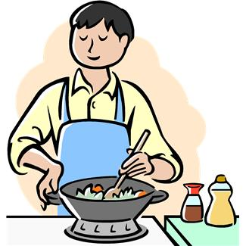
Topic 5 – 10 Points
QUESTION:
What is John doing now?
ANSWER:
John is cooking.

Slide 24
Topic 5 – 20 Points
QUESTION:
What is Sally doing?
ANSWER:
Sally is reading

Slide 25
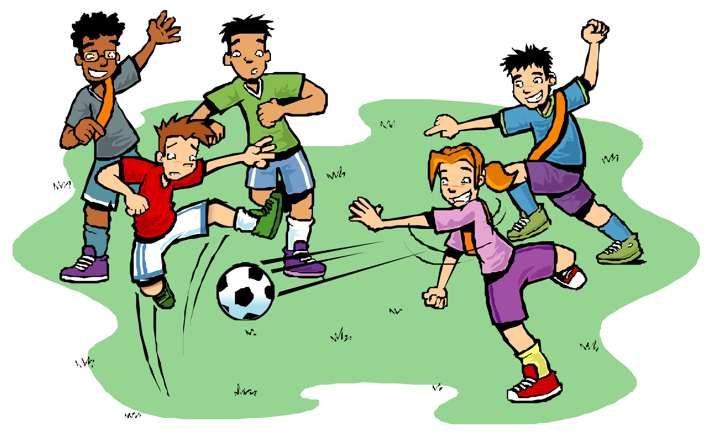
Topic 5 – 30 Points
QUESTION:
What are they doing now?
ANSWER:
They are
playing soccer.

Slide 26
Topic 5 – 40 Points
QUESTION:
ANSWER

Slide 27
Topic 5 – 50 Points
QUESTION:
ANSWER:

