Slide 1
Jeopardy
Unit1~Unit3

Slide 2
Jeopardy
 | English ↓ Japanese | Japanese ↓ English | Yes No Questions | Contents
Unit1-1 | Jeopardy Unit1-1 | Jeopardy Unit1-1 | Jeopardy Unit1-1 | Jeopardy Unit1-1
Unit1-2 | Jeopardy Unit1-2 | Jeopardy Unit1-2 | Jeopardy Unit1-2 | Jeopardy Unit1-2
Unit1-3 | Jeopardy Unit1-3 | Jeopardy Unit1-3 | Jeopardy Unit1-3 | Jeopardy Unit1-3
Unit2-1 | Jeopardy Unit2-1 | Jeopardy Unit2-1 | Jeopardy Unit2-1 | Jeopardy Unit2-1
Unit2-2 | Jeopardy Unit2-2 | Jeopardy Unit2-2 | Jeopardy Unit2-2 | Jeopardy Unit2-2
Unit2-3 | Jeopardy Unit2-3 | Jeopardy Unit2-3 | Jeopardy Unit2-3 | Jeopardy Unit2-3
Unit3-1 | Jeopardy Unit3-1 | Jeopardy Unit3-1 | Jeopardy Unit3-1 | Jeopardy Unit3-1
Uni-3-2 | Jeopardy Unit3-2 | Jeopardy Unit3-2 | Jeopardy Unit3-2 | Jeopardy Unit3-2
Unit3-3 | Jeopardy Unit3-3 | Jeopardy Unit3-3 | Jeopardy Unit3-3 | Jeopardy Unit3-3

Slide 3
Jeopardy Unit1-1
I
わたしは

Slide 4
Jeopardy Unit1-2
yes
はい

Slide 5
Jeopardy Unit1-3
fan
ファン

Slide 6
Jeopardy Unit2-1
this
こちらは
これは

Slide 7
Jeopardy Unit2-2
picture
写真
絵

Slide 8
Jeopardy Unit2-3
our
私たちの

Slide 9
Jeopardy Unit3-1
band
バンド

Slide 10
Jeopardy Unit3-2
write
書く

Slide 11
Jeopardy Unit3-3
about
～について

Slide 12
Jeopardy Unit1-1
朝
morning

Slide 13
Jeopardy Unit1-2
部活
club

Slide 14
Jeopardy Unit1-3
みなさん
everyone

Slide 15
Jeopardy Unit2-1
あなたの
your

Slide 16
Jeopardy Unit2-2
公園
park

Slide 17
Jeopardy Unit2-3
先生
teacher

Slide 18
Jeopardy Unit3-1
数学
math

Slide 19
Jeopardy Unit3-2
練習する
practice

Slide 20
Jeopardy Unit3-3
一員
member

Slide 21
Jeopardy Unit1-1
Are you a student?
Yes, I am.

Slide 22
Jeopardy Unit1-2
Are you in the judo club?
Yes, I am.
No, I’m not.

Slide 23
Jeopardy Unit1-3
Are you from Miyako?
Yes, I am.
No, I’m not.

Slide 24
Jeopardy Unit2-1
Is this a pen?
Yes, it is.
No, it’s not.

Slide 25
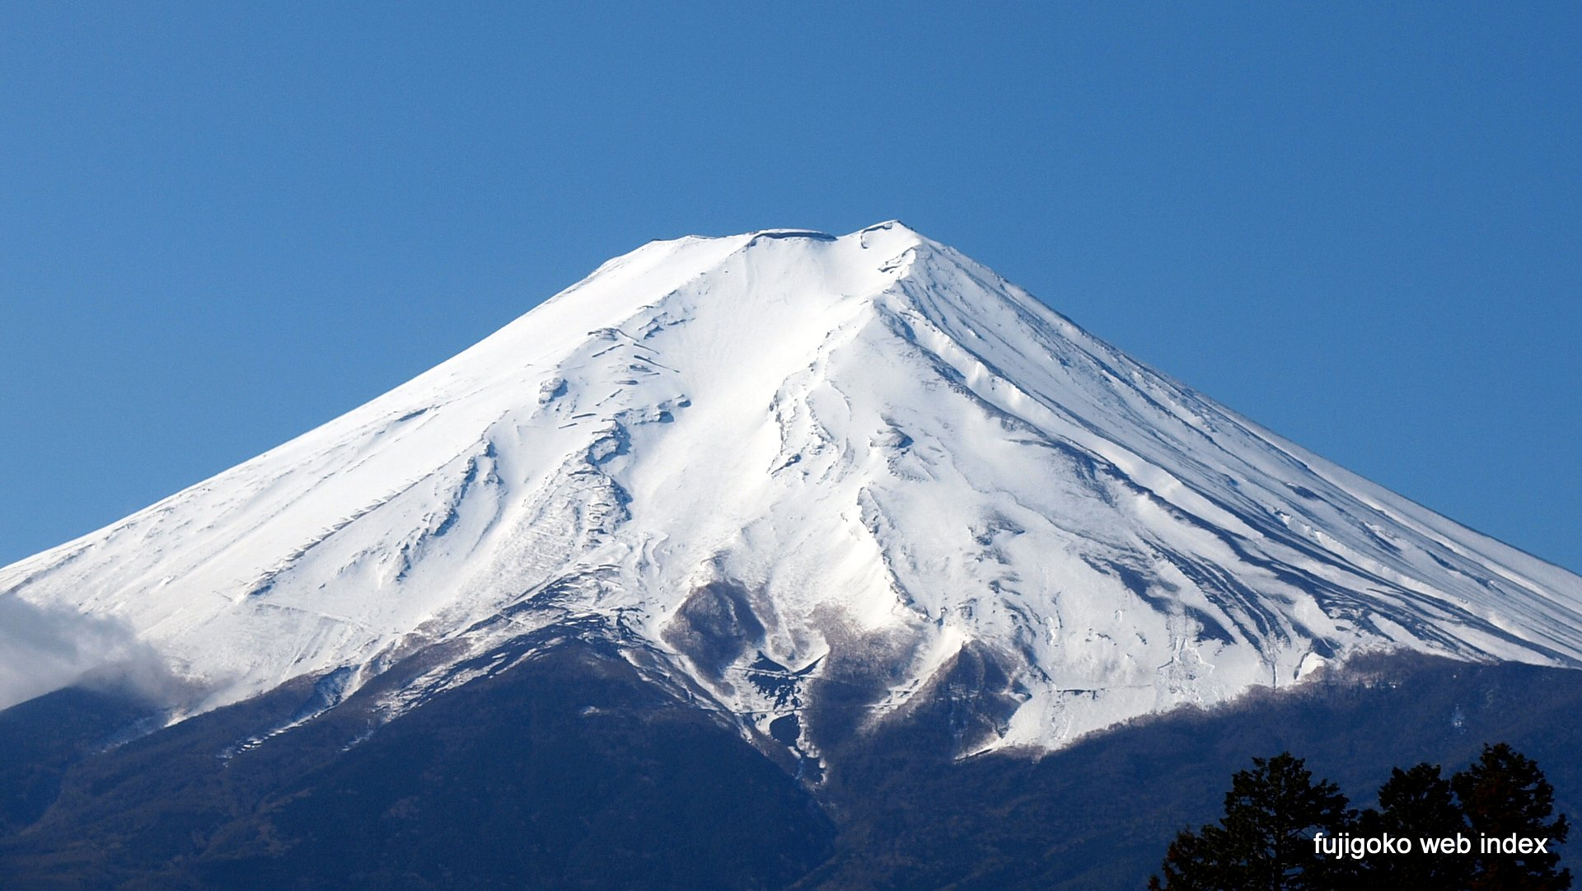
Jeopardy Unit2-2
Is that Mt. Fuji?
Yes, it is.
No, it’s not.

Slide 26
Jeopardy Unit2-3
Is Mr. Nakamura
a science teacher?
Yes, he is.
No, he’s not.

Slide 27
Jeopardy Unit3-1
Do you like music?
Yes, I do.
No, I don’t.

Slide 28
Jeopardy Unit3-2
Do you play the sanshin?
Yes, I do.
No, I don’t.

Slide 29
Jeopardy Unit3-3
Do you know about baseball?
Yes, I do.
No, I don’t.

Slide 30
Jeopardy Unit1-1
ベイカー先生の名前は？
Ellen

Slide 31
Jeopardy Unit1-2
咲の名字は？
Ando

Slide 32
Jeopardy Unit1-3
ベイカー先生の出身地は？
Boston

Slide 33
Jeopardy Unit2-1
Thank you.
You’re welcome.

Slide 34
Jeopardy Unit2-2
デパートを英語で
department store

Slide 35
Jeopardy Unit2-3
アレックスの出身地は？
Canada

Slide 36
Jeopardy Unit3-1
ディーパは何歳？
twelve

Slide 37
Jeopardy Unit3-2
ディーパはピアノを弾きますか？
No

Slide 38
Jeopardy Unit3-3
光太がするスポーツは？
soccer

