Slide 1
Jeopardy
Unit1~Unit3

Slide 2
Jeopardy
 | English ↓ Japanese | Japanese ↓ English | Yes No Questions | Contents
１００ | Jeopardy Unit1-3 | Jeopardy Unit1-3 | Jeopardy Unit1-3 | Jeopardy Unit1-3
２００ | Jeopardy Unit2-1 | Jeopardy Unit2-1 | Jeopardy Unit2-1 | Jeopardy Unit2-1
３００ | Jeopardy Unit2-2 | Jeopardy Unit2-2 | Jeopardy Unit2-2 | Jeopardy Unit2-2
４００ | Jeopardy Unit2-3 | Jeopardy Unit2-3 | Jeopardy Unit2-3 | Jeopardy Unit2-3
５００ | Jeopardy Unit3-1 | Jeopardy Unit3-1 | Jeopardy Unit3-1 | Jeopardy Unit3-1
６００ | Jeopardy Unit3-2 | Jeopardy Unit3-2 | Jeopardy Unit3-2 | Jeopardy Unit3-2
７００ | Jeopardy Unit3-3 | Jeopardy Unit3-3 | Jeopardy Unit3-3 | Jeopardy Unit3-3

Slide 3
Jeopardy Unit1-3 English-Japanese
fan
ファン

Slide 4
Jeopardy Unit2-1 English-Japanese
this
こちらは
これは

Slide 5
Jeopardy Unit2-2 English-Japanese
picture
写真
絵

Slide 6
Jeopardy Unit2-3 English-Japanese
our
私たちの

Slide 7
Jeopardy Unit3-1 English-Japanese
band
バンド

Slide 8
Jeopardy Unit3-2 English-Japanese
write
書く

Slide 9
Jeopardy Unit3-3 English-Japanese
about
～について

Slide 10
Jeopardy Unit1-3 Japanese-English
みなさん
everyone

Slide 11
Jeopardy Unit2-1 Japanese-English
あなたの
your

Slide 12
Jeopardy Unit2-2 Japanese-English
公園
park

Slide 13
Jeopardy Unit2-3 Japanese-English
先生
teacher

Slide 14
Jeopardy Unit3-1 Japanese-English
数学
math

Slide 15
Jeopardy Unit3-2 Japanese-English
練習する
practice

Slide 16
Jeopardy Unit3-3 Japanese-English
一員
member

Slide 17
Jeopardy Unit1-3 Qustion
Are you from Miyako?
Yes, I am.
No, I’m not.

Slide 18
Jeopardy Unit2-1 Question
Is this a pen?
Yes, it is.

Slide 19
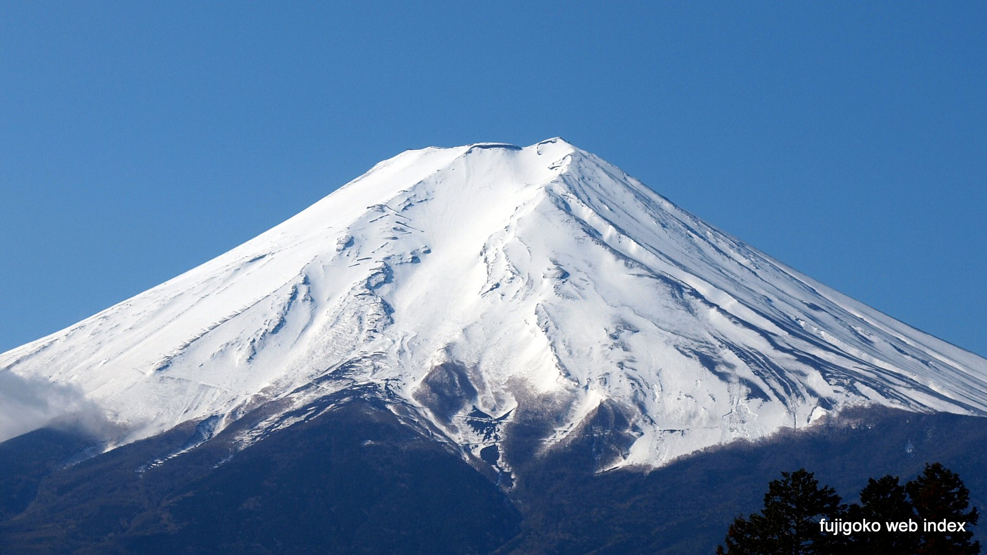
Jeopardy Unit2-2 Question
Is that Mt. Fuji?
Yes, it is.

Slide 20
Jeopardy Unit2-3 Question
Is Mr. Tokumine
a science teacher?
No, he is not.

Slide 21
Jeopardy Unit3-1 Question
Do you like music?
Yes, I do.
No, I don’t.

Slide 22
Jeopardy Unit3-2 Question
Do you play the sanshin?
Yes, I do.
No, I don’t.

Slide 23
Jeopardy Unit3-3 Question
Do you know about baseball?
Yes, I do.
No, I don’t.

Slide 24
Jeopardy Unit1-3 Contents
ベイカー先生の出身地は？
Boston

Slide 25
Jeopardy Unit2-1 Contents
Thank you.
You’re welcome.

Slide 26
Jeopardy Unit2-2 Contents
デパートを英語で
department store

Slide 27
Jeopardy Unit2-3 Contents
アレックスの出身地は？
Canada

Slide 28
Jeopardy Unit3-1 Contents
ディーパは何歳？
twelve

Slide 29
Jeopardy Unit3-2 Contents
ディーパはピアノを弾きますか？
No

Slide 30
Jeopardy Unit3-3 Contents
光太がするスポーツは？
soccer

