Slide 1
Jeopardy
Unit4 ホームパーティー

Slide 2
Jeopardy -Unit4-
English ↓ Japanese | Japanese ↓ English | Scramble words | Questions | Contents
100 | 100 | 100 | 100 | 100
200 | 200 | 200 | 200 | 200
300 | 300 | 300 | 300 | 300
400 | 400 | 400 | 400 | 400
500 | 500 | 500 | 500 | 500

Slide 3
Jeopardy English-Japanese100
we
私たちは、ぼくたちは

Slide 4
Jeopardy English-Japanese200
many
たくさんの

Slide 5
Jeopardy English-Japanese300
too much
あまりにもたくさんの

Slide 6
Jeopardy English-Japanese400
I see.
なるほど。分かった。

Slide 7
Jeopardy English-Japanese500
Thank you very much.
どうもありがとうございます。

Slide 8
Jeopardy Japanese-English100
彼らは、彼女らは
they

Slide 9
Jeopardy Japanese-English200
全部
all

Slide 10
Jeopardy Japanese-English300
すみません。
Excuse me.

Slide 11
Jeopardy Japanese-English400
おつりをどうぞ。
Here’s your change.

Slide 12
Jeopardy Japanese-English500
９８０円です。
Nine hundred and eighty yen.

Slide 13
Jeopardy scramble words100
y - a - n
any

Slide 14
Jeopardy scramble words200
e – s - e
see

Slide 15
Jeopardy scramble words300
a - b - c - k
back

Slide 16
Jeopardy scramble words400
a - e - h - v
have

Slide 17
Jeopardy scramble words500
a - e - n - p - r - s - t
parents

Slide 18
Jeopardy Questions100
Do you have any pets?
Yes, I do.
No, I don’t.

Slide 19
Jeopardy Questions200
How many pens do you have?
I have ○○ pens.
数字
no
many

Slide 20
Jeopardy Questions300
How many books do you have?
I have ○○ books.
数字
no
many

Slide 21
Jeopardy Questions400
How many T-shirt do you want?
I want ○○ T-shirts.
数字
no
many

Slide 22
Jeopardy Questions500
Let’s go to a movie.
OK.
Sorry.

Slide 23
Jeopardy Contents 100
Thank you very much.
You’re welcome.

Slide 24
Jeopardy Contents 200
Do you have any pets?
（ベイカー先生になりきって答える）
Yes, I do.

Slide 25
Jeopardy Contents 300
How many rabbits do you have?
（ベイカー先生の両親になりきって答える）
Three.

Slide 26
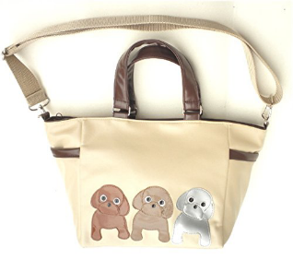
Jeopardy Contents 400
Which is doggy bag?
A | B

Slide 27
Jeopardy Contents 500
What do you put in the doggy bag?
Food.

