Slide 1
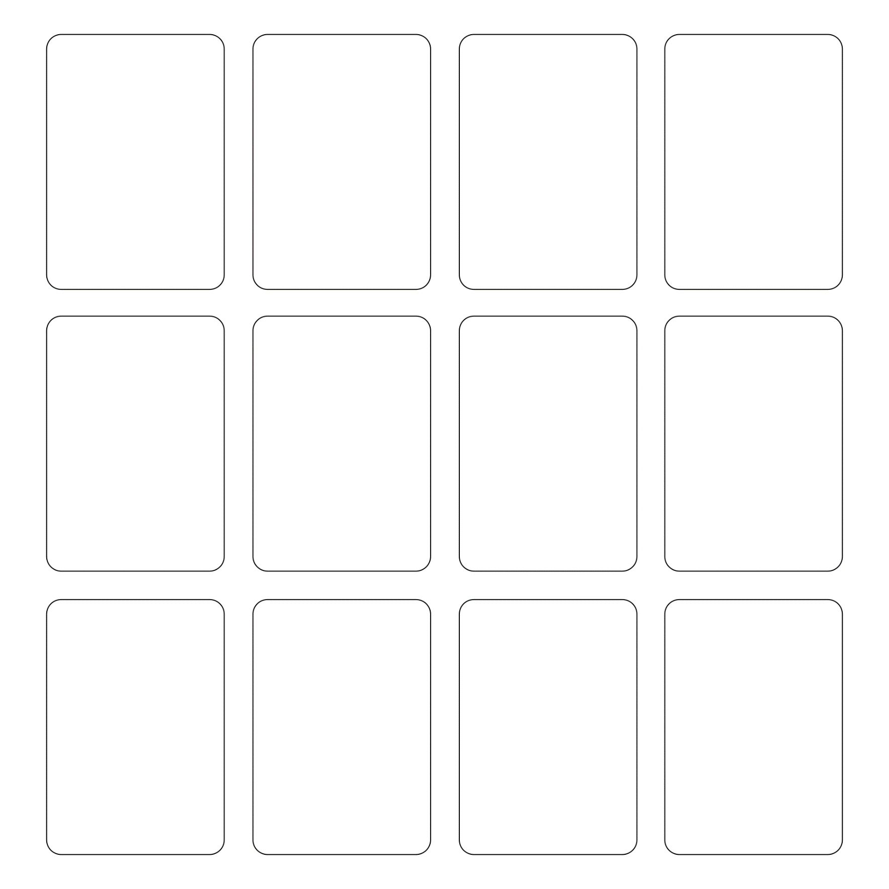
snake
boy band
sushi chef
France
*choose any anime character*
Sherlock Holmes
Canada
piranhas
Obama
BTS
frog
turtle

Slide 3
Thomas the Tank Engine
Crayon Shin Chan
Spongebob
France
*choose any video game character*
Queen Elizabeth II
Doraemon
No-Face
(カオナシ)
gorilla
pirate
evil doll
Godzilla

Slide 5
King Kong
Mothra
kappa
Pikachu
*choose any movie character*
Wario
octopus
zombie
The person to your right
tanuki
demon
Detective Conan

Slide 7
Mario and Luigi
Kinopio
Harry Potter
Army of skeletons
*choose any famous person*
yourself
dragon
cat
giraffe
cowboy
assassin
E.T.

Slide 9
Snoopy
mummy
Mickey Mouse
sumo wrestler
The Statue of Liberty
Totoro
wizard
ninja
samurai
Jaws
Spiderman
Winnie the Pooh

Slide 11
Animal Crossing villager
(どうぶつの森からの人)
Sailor Moon
Luffy
sumo wrestler
An army of elementary school students
lizard
elephant
duck
Rilakkuma
Hello Kitty
Gudetama
Astro Boy

Slide 13
Dinosaur
Naruto
Goku
Shinkansen
Tom and Jerry
Yoshi
The Hanshin Tigers
Donald Duck
Mozart
Walt Disney
Mary Poppins
Steve Jobs

Slide 15
Can breathe underwater
Has 2 extra arms
100 of them
Can read minds
Riding a war elephant
Can control plants
Can kill with a kiss
Has a big sword
Can’t stop dancing
Is invisible
Is super strong
Can fly

Slide 17
Is very big
Can travel in time
Can only see movement
Is very small
Riding a tiger
50 of them
No arms
No legs
3 of them
Can shoot lasers
Made of sand
Controls weather

Slide 19
Riding a motorcycle
Can shoot acid
Has only one leg
Has only one arm
Has 2 extra legs
5 of them
Is a kung-fu master
Clothes are too big
Can become any animal
Has no shoes
Riding a bicycle
Is 1000 years old

Slide 21
Is super fast
Is super slow
Clothes are too small
Can control animals
Can jump super high
Can predict the future
Allergic to water
Allergic to all animals
Wearing a fancy dress
Can become metal
Can control machines
Is a baby

Slide 23
Has an army of cats
Has an army of dogs
Is very sad
Just drank 5 cups of coffee
Can’t see
Riding a unicycle
Wearing a funny hat
*choose a new fighter*
They are your sidekick!
*choose a new fighter*
They are your sidekick!
*choose a new fighter*
They are your sidekick!
*choose a new fighter*
They are your sidekick!
*choose a new fighter*
They are your sidekick!

Slide 25
Is 300kg
Is super smart
Has magic powers
Can eat anything
Can understand all languages
Can control bugs
Can talk to ghosts
Has 2 heads
Can stop time for 5 seconds
Has a laser gun
Has a [extra] tail
Has a katana

Slide 27
Has 3 heads
Can control electricity
Has really long hair
Has a spoon
Has a giant fork
Can’t hear
Can control water
Has a magic wand
Has wings, but can’t fly
Has 2 extra eyes
Is very sticky all over
Made of snow

Slide 29
Is carrying a baby
Has tiny legs
Sidekick is Doraemon
Sidekick is a ninja
Sidekick is Spongebob
Sidekick is Snoopy
Sidekick is a demon
Sidekick is a wizard
Can regrow arms and legs
Sidekick is a cowboy
Sidekick is a zombie
Has nunchucks

Slide 31
Sidekick is Harry Potter
Sidekick is Rilakkuma
Is made of lava
Is covered in spikes
Hands are scissors
Has a giant stapler
Has an army of flying monkeys
Can’t stop singing
Hands are fish
Is inside a giant ball
Has tiny arms
Can steal opponent’s powers

