Slide 1
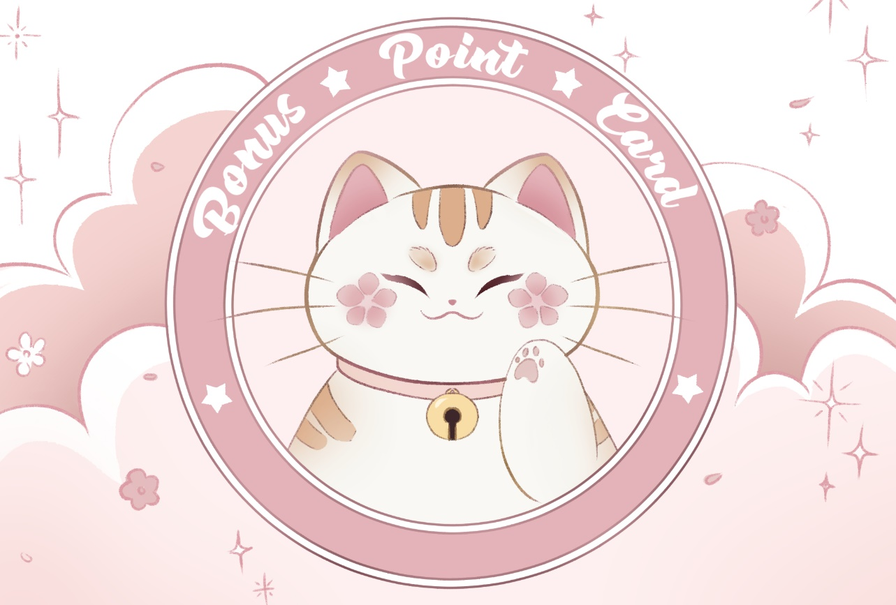

Slide 2
Good Job!
Good Job!
Good Job!
Good Job!
Good Job!
Good Job!
Good Job!
Good Job!
Good Job!
Good Job!
Good Job!
Good Job!
Good Job!
Good Job!
Good Job!
Good Job!
Good Job!
Good Job!
Good Job!
Good Job!
Good Job!
Good Job!
Good Job!
Good Job!
Good Job!
Good Job!
Good Job!
Good Job!
Good Job!
Good Job!
Good Job!
Good Job!
Good Job!
Good Job!
Good Job!
Good Job!
Good Job!
Good Job!
Good Job!
Good Job!
Good Job!
Good Job!
Good Job!
Good Job!
Good Job!
Good Job!
Good Job!
Good Job!
Good Job!
Good Job!
Good Job!
Good Job!
Good Job!
Good Job!
Good Job!
Good Job!
Good Job!
Good Job!
Good Job!
Good Job!
Good Job!
Good Job!
Good Job!
Good Job!
Good Job!
Good Job!
Good Job!
Good Job!
Good Job!
Good Job!
Good Job!
Good Job!

