Slide 1
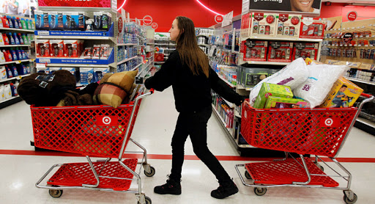
What do you want? PART TWO

Slide 2
ONE

Slide 3
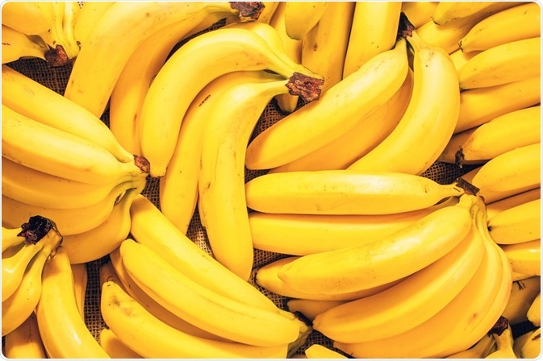
What do you want?
I want bananas please.
ANSWER

Slide 4
TWO

Slide 5
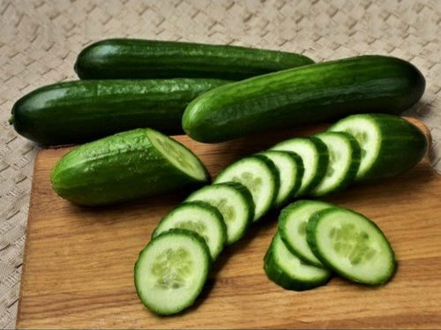
What do you want?
I want cucumbers please.
ANSWER

Slide 6
THREE

Slide 7
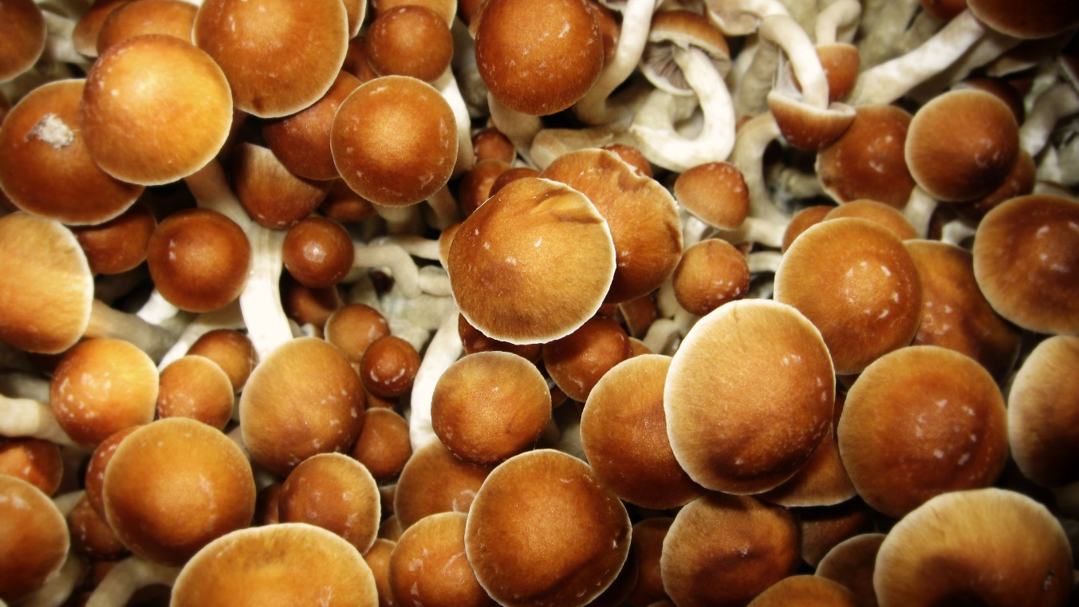
What do you want?
I want mushrooms please.
ANSWER

Slide 8
LAST

Slide 9
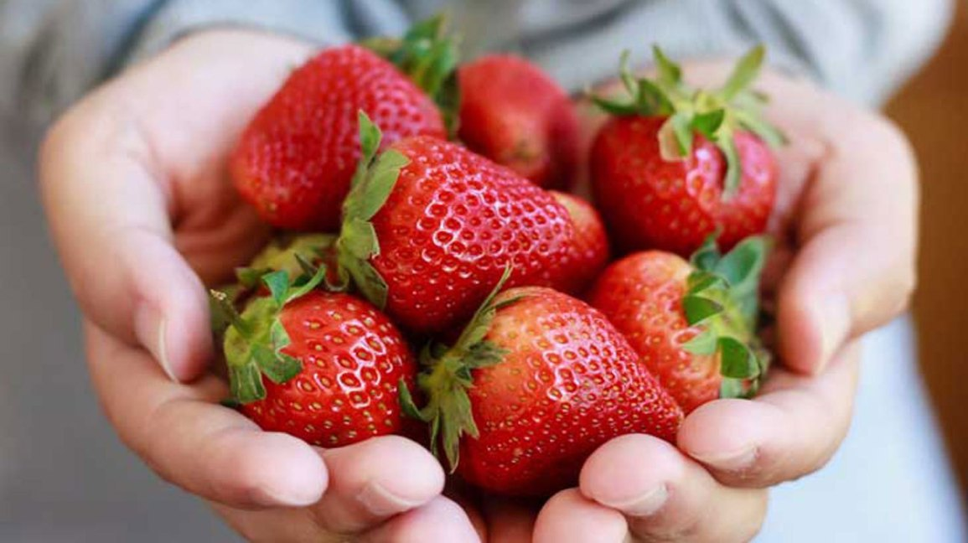
What do you want?
I want strawberries please.
ANSWER

Slide 10
THE END

