Slide 1
PART
TWO
GIVING DIRECTIONS

Slide 2
GO STRAIGHT!
TURN RIGHT!
TURN LEFT!
GO BACK!

Slide 3
ONCE MORE

Slide 4
GO STRAIGHT!
TURN RIGHT!
TURN LEFT!
GO BACK!

Slide 5
SPOT THE DOG!

Slide 6
ONE

Slide 7
GO STRAIGHT!

Slide 8
TWO

Slide 9
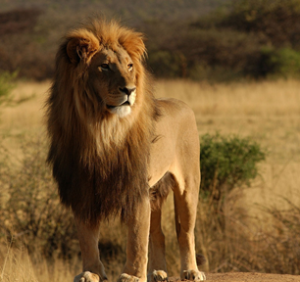
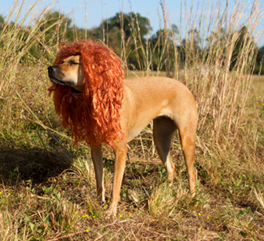
TURN RIGHT!

Slide 10
THREE

Slide 11
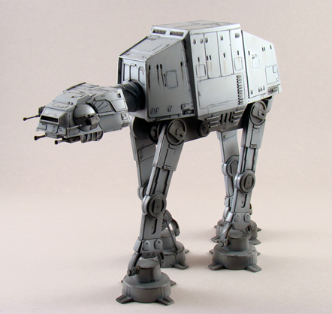
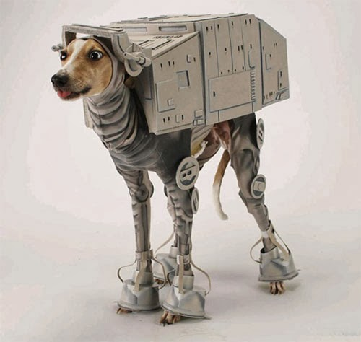
GO BACK!

Slide 12
LAST

