Slide 1
Hidden picture drawing game!

Slide 2
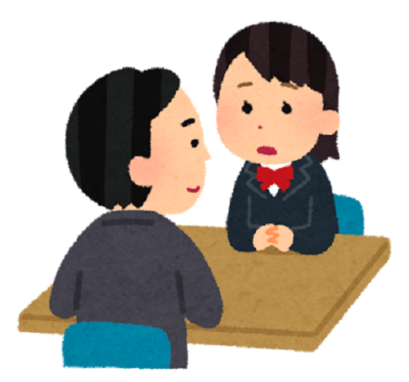
How to play
First draw a red circle…
Notes:
Students make pairs. One student can see the board but can’t see the tablet. One student is drawing on the tablet but can’t see the board. The student that can see the drawing on the board must describe it to their partner, and their partner draws according to the instructions. At the end, check to see how close your drawing is!

Slide 3
Draw a circle above square on top triangle under rectangle
inside outside
in the middle on the left Draw a line up and down on the right Draw a line side to side

