Slide 1
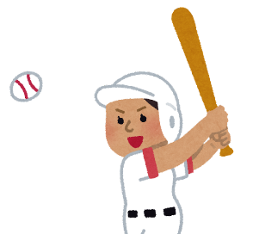
Print in B&W and color over w/ color pencils etc.
or
Print in color w/ these if you’d like:
I like blue.
purple
brown
blue
white
yellow
soccer
red
pink
baseball
orange
green
black

Slide 2
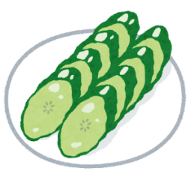
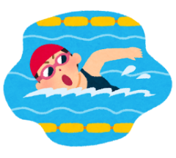
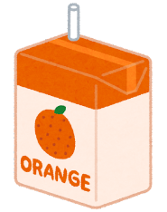
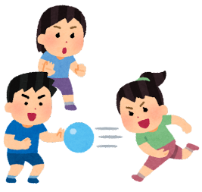
I like blue.
cucumber
soccer
milk
swimming
ice cream
green pepper
onion
orange juice
carrot
basketball
dodgeball
pudding

