Slide 1
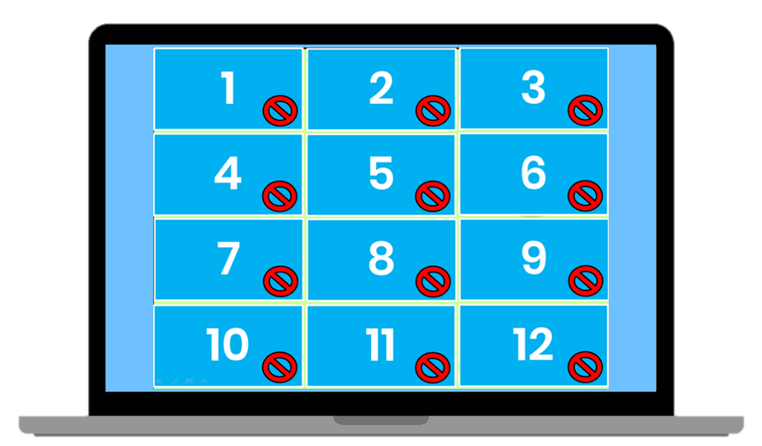
Matching Game
How to Play
Divide the class into two teams. Each team then takes turns in choosing TWO numbered squares. If the two squares are the same word / picture, then the team gets a point. If the two squares are different, then click on the red circle to hide the picture again. Students must try to remember where the matching pairs of words are.

Slide 2
a | L | q | K | r | H
G | b | B | p | Q | l
k | P | g | h | A | R
1
2
3
4
5
6
7
8
9
10
11
12
13
14
15
16
17
18

