Slide 1
Guess the price in the U.S.

Slide 2
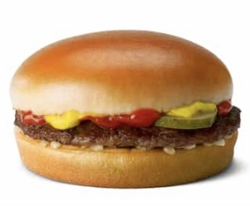
Japan: \170
The U.S. : $2.69
\398

Slide 3
Japan: \190
The U.S. : $3.69
\546

Slide 4
Japan: \210
The U.S. : $2.09
\309

Slide 5
Japan: \170
The U.S. : $3.69
\546

Slide 6
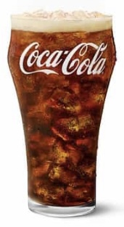
Japan: \120
The U.S. : $2.19
\324

Slide 7
Japan: \120
The U.S. : $2.29
\339

