Slide 1
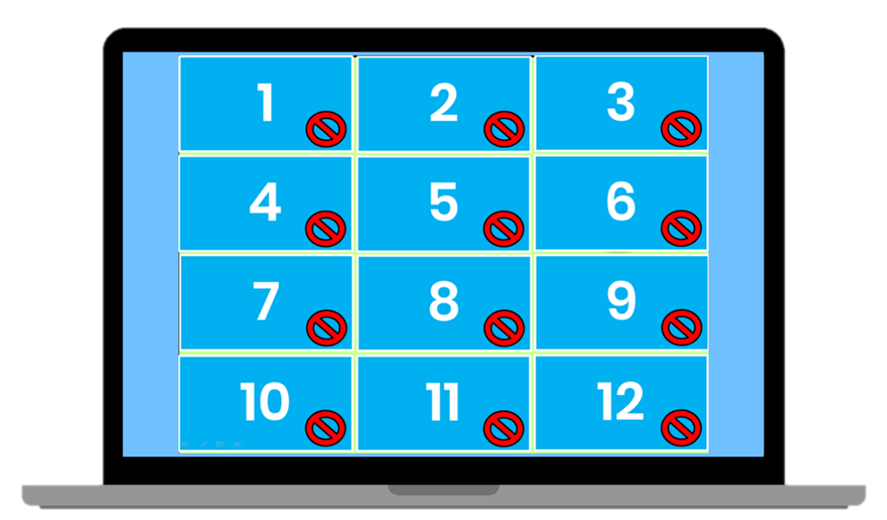
Matching Game
How to Play
Divide the class into two teams. Each team then takes turns in choosing TWO numbered squares. If the two squares are the same word / picture, then the team gets a point. If the two squares are different, then click on the red circle to hide the picture again. Students must try to remember where the matching pairs of words are.

Slide 2
F | j | I | t | n | J
y | N | m | E | d | Y
T | D | e | f | M | i
1
2
3
4
5
6
7
8
9
10
11
12
13
14
15
16
17
18

