Slide 1
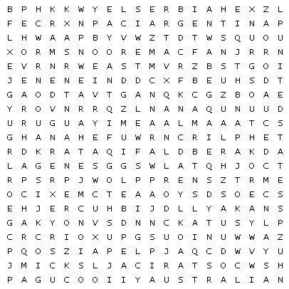
World Cup wordsearch
Argentina | Australia | Belgium
Brazil | Cameroon | Canada
Costa Rica | Croatia | Denmark
Ecuador | England | France
Germany | Ghana | Iran
Japan | Mexico | Morocco
Netherlands | Poland | Portugal
Qatar | Saudi Arabia | Senegal
Serbia | South Korea | Spain
Switzerland | Tunisia | United States
Uruguay | Wales

Slide 2
