Slide 1
What gifts do you want ?
birthday gift ... holiday gift ... etc...

Slide 2
Which do you want ?
THIS
THAT

Slide 3
Let’s try !
I want ______ because ...

Slide 4
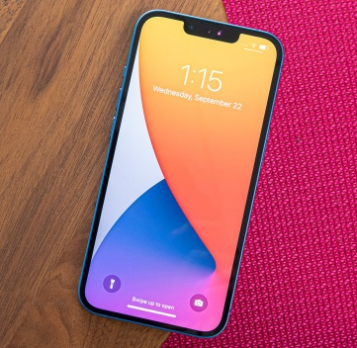
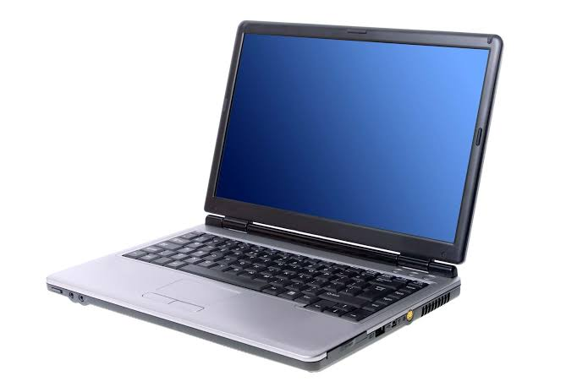
Which do you want ?
phone
computer
?

Slide 5
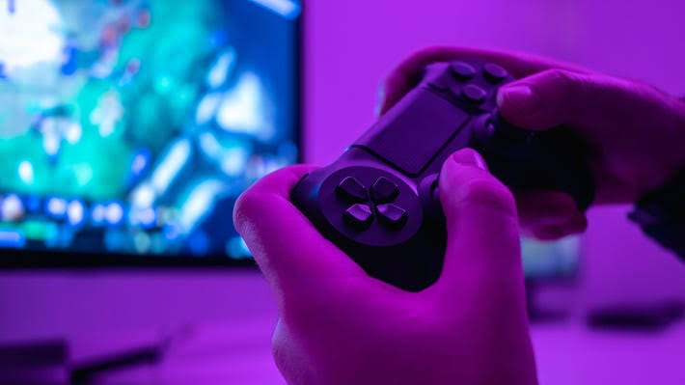
I want ... Because ...
( better )
computer
play games

Slide 6
There is one rule ...

Slide 7
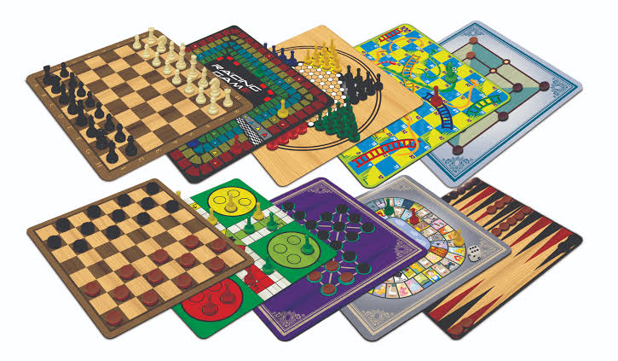
Which do you want ? Why ?
video game
boardgame

Slide 8
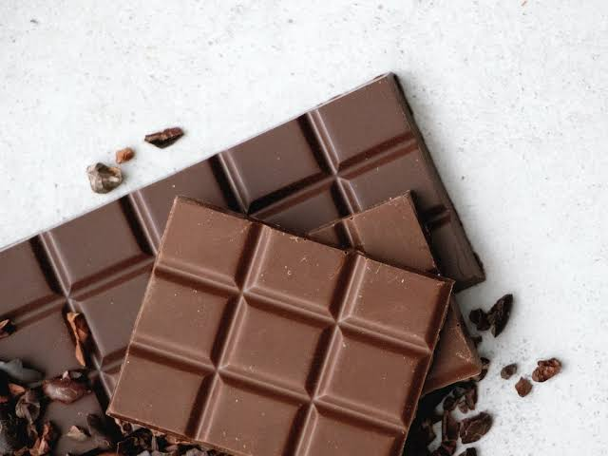
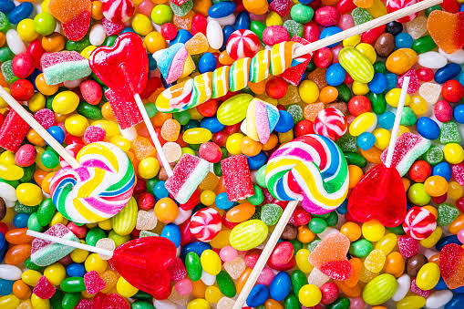
Which do you want ? Why ?
chocolate
candy

Slide 9
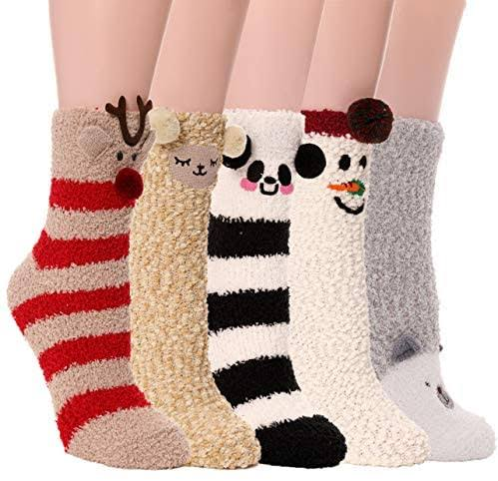
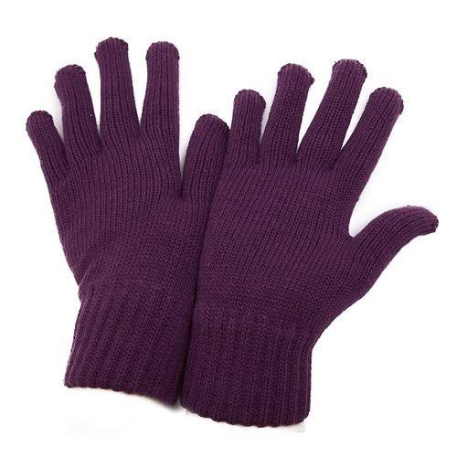
Which do you want ? Why ?
socks
gloves

Slide 10
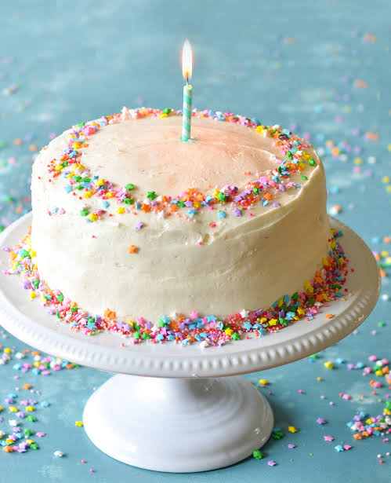
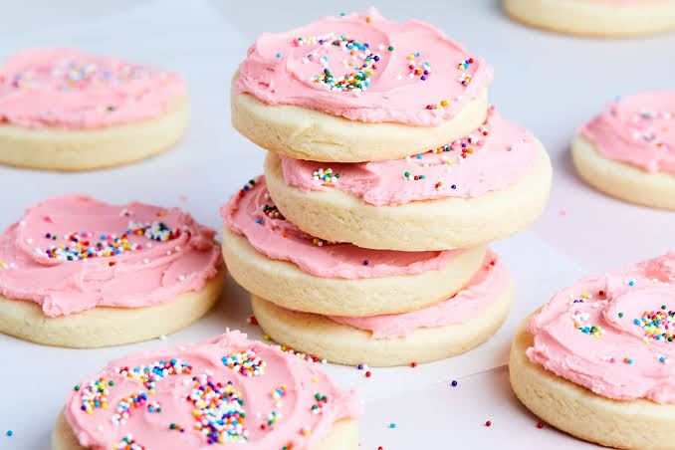
Which do you want ? Why ?
cake
cookies

Slide 11
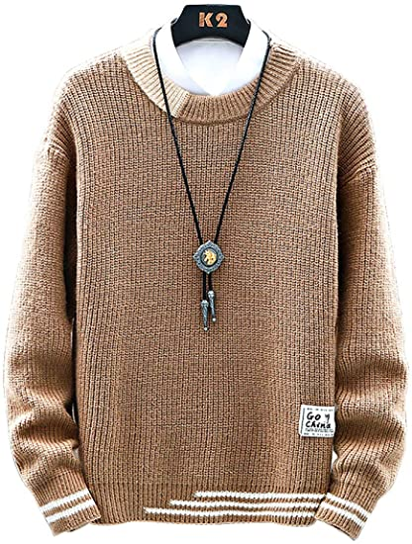
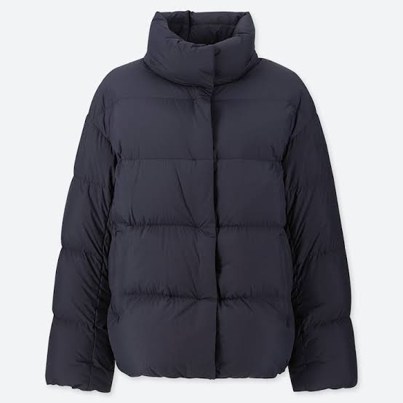
Which do you want ? Why ?
sweater
coat

Slide 12
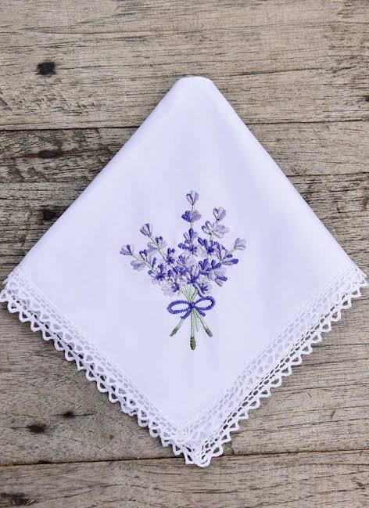
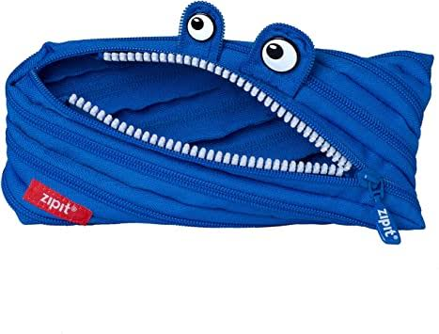
Which do you want ? Why ?
handkerchief
pencil case

Slide 13
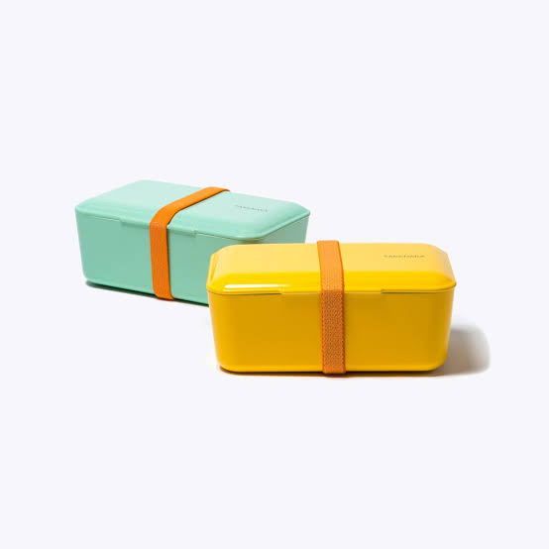
Which do you want ? Why ?
thermos
lunchbox

Slide 14
Finally ...

Slide 15
What gift is the best ?
The best gift is _____ because ... (1), (2), (3) .

Slide 16
What gift is the best ?

