Slide 1
Jeopardy
二年生

Slide 2
Jeopardy
Change to 過去形 | Word jumble | Scramble words | Questions | Japanese to English
100 | 100 | 100 | 100 | 100
200 | 200 | 200 | 200 | 200
300 | 300 | 300 | 300 | 300
400 | 400 | 400 | 400 | 400
500 | 500 | 500 | 500 | 500

Slide 3
Jeopardy Change 100
I go to Okinawa.
I went to Okinawa.

Slide 4
Jeopardy Change 200
It is a good day today.
It was a good day today.

Slide 5
Jeopardy Change 300
I have fun in English class.
I had fun in English class.

Slide 6
Jeopardy Change 400
I go to see a movie.
I went to see a movie.

Slide 7
Jeopardy Change 500
We have a video chat
and talk.
We had a video chat and talked.

Slide 8
Jeopardy Word jumble 100
went
to
I
Busan
I went to Busan.

Slide 9
Jeopardy Word jumble 200
I
this morning
breakfast
had
I had breakfast this morning.

Slide 10
Jeopardy Word jumble 300
talking with
I
my
was
friend
I was talking with my friend.

Slide 11
Jeopardy Word jumble 400
good time
She
a
had
yesterday
She had a good time yesterday.

Slide 12
Jeopardy Word jumble 500
play
I usually
in
the evening
my dog
with
I usually play with my dog in the evening.

Slide 13
Jeopardy scramble words 100
o-d
do

Slide 14
Jeopardy scramble words 200
t-e-a
eat

Slide 15
Jeopardy scramble words 300
l-k-a-t
talk

Slide 16
Jeopardy scramble words 400
y-t-d-u-s
study

Slide 17
Jeopardy scramble words 500
n-s-t-l-i-e
listen

Slide 18
Jeopardy Questions 100
Did you play video games last night?
Yes, I did.
No, I didn’t.

Slide 19
Jeopardy Questions 200
Were you busy yesterday?
Yes, I was.
No, I wasn’t.

Slide 20
Jeopardy Questions 300
Do you like playing sports?
Yes, I do.
No, I don’t.

Slide 21
Jeopardy Questions 400
What kind of music do you like?
I like___ _____.

Slide 22
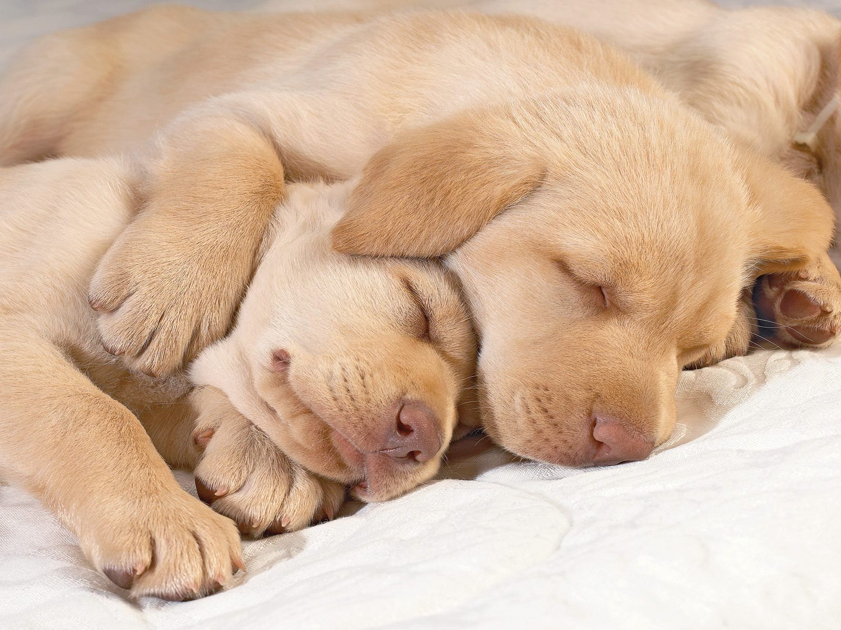
Jeopardy Questions 500
What were they doing?
They were sleeping.

Slide 23
Jeopardy Japanese to English 100
私は暇の時は
When I’m free

Slide 24
Jeopardy Japanese to English 200
昨晩
Last night

Slide 25
Jeopardy Japanese to English 300
ジョンはスポーツを
遊ぶことが好きですか
Does John like playing sports?

Slide 26
Jeopardy Japanese to English 400
私は小学校にいったときは
When I was in elementary school

Slide 27
Jeopardy Japanese to English 500
私は沖縄のいとこを
訪ねているつもりです。
I’m going to visit my cousins in Okinawa.

