Slide 1
Quiz Time!
Are you…? / Do you…?

Slide 2
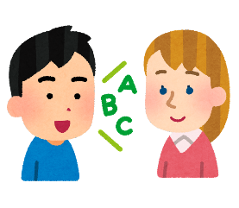
What’s the difference?
Are you from Japan?
Do you speak English?

Slide 3
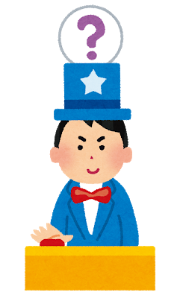
QUIZ
TIME

Slide 4
ROUND ONE

Slide 5
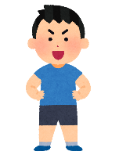
Are you…? / Do you…?
Doing judo makes me tired
__________ 12 years old?
Are you 12 years old?

Slide 6
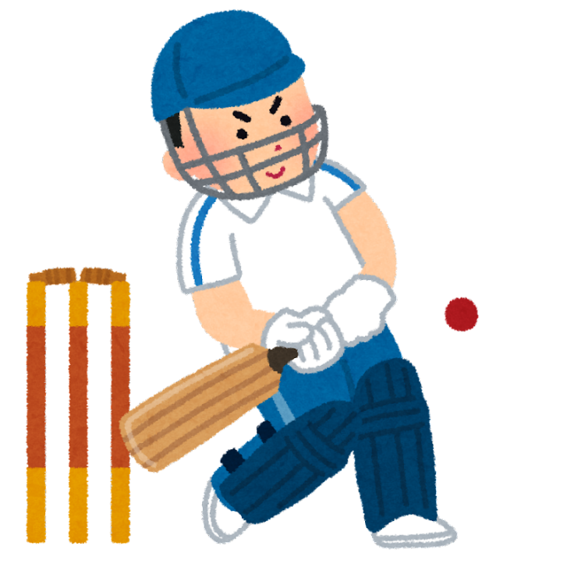
Are you…? / Do you…?
Doing judo makes me tired
__________ play cricket?
Do you play cricket?

Slide 7
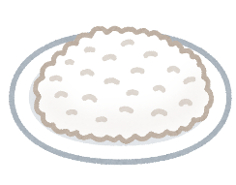
Are you…? / Do you…?
Doing judo makes me tired
__________ eat rice for breakfast?
Do you eat rice for breakfast?

Slide 8
Are you…? / Do you…?
Doing judo makes me tired
__________ happy now?
Are you happy now?

Slide 9
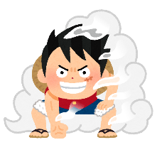
Are you…? / Do you…?
Doing judo makes me tired
__________ like anime?
Do you like anime?

Slide 10
LEVEL UP!

Slide 11
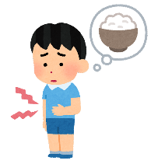
Are you…? / Do you…?
____________ hungry?
Doing judo makes me tired
____________________________
Are you hungry?

Slide 12
Are you…? / Do you…?
Doing judo makes me tired
______________________?
_________ speak English?
Do you speak English?

Slide 13
Are you…? / Do you…?
Do you sing karaoke?
Doing judo makes me tired
________________________?
_________ sing karaoke?

Slide 14
Are you…? / Do you…?
Doing judo makes me tired
_______________________?
____________ from Spain?
Are you from Spain?

Slide 15
Are you…? / Do you…?
_____________________?
____________ a teacher?
Are you a teacher?

