Slide 1
Jeopardy
一年生Unit ２

Slide 2
Jeopardy
Correct the sentence | Word jumble | Scramble words | Questions | Japanese to English
100 | 100 | 100 | 100 | 100
200 | 200 | 200 | 200 | 200
300 | 300 | 300 | 300 | 300
400 | 400 | 400 | 400 | 400
500 | 500 | 500 | 500 | 500

Slide 3
Jeopardy Change 100
Here the brass band.
Here’s the brass band.

Slide 4
Jeopardy Change 200
Are you soccer fan?
Are you a soccer fan?

Slide 5
Jeopardy Change 300
Can you reed it?
Can you read it?

Slide 6
Jeopardy Change 400
We have school at Monday.
We have school on Monday.

Slide 7
Jeopardy Change 500
Can you swim good?
Can you swim well?

Slide 8
Jeopardy Word jumble 100
artist
?
Are
you
an
Are you an artist?

Slide 9
Jeopardy Word jumble 200
play the
piano?
Can
you
Can you play the piano?

Slide 10
Jeopardy Word jumble 300
a
Are
you
fan?
soccer
Are you a soccer fan?

Slide 11
Jeopardy Word jumble 400
usually
practice
on
Friday
We
We usually practice on Friday.

Slide 12
Jeopardy Word jumble 500
like
outdoor
Do
sports?
you
Do you like outdoor sports?

Slide 13
Jeopardy scramble words 100
B-a-s-s-r
B-n-d-a
Brass band

Slide 14
Jeopardy scramble words 200
D-a-m-a-r
B-c-l-u
Drama club

Slide 15
Jeopardy scramble words 300
a-t-r
l-u-b-c
Art club

Slide 16
Jeopardy scramble words 400
a-c-k-t-r
T-a-e-m
Track team

Slide 17
Jeopardy scramble words 500
S-i-m-w
a-e-m-t
Swim team

Slide 18
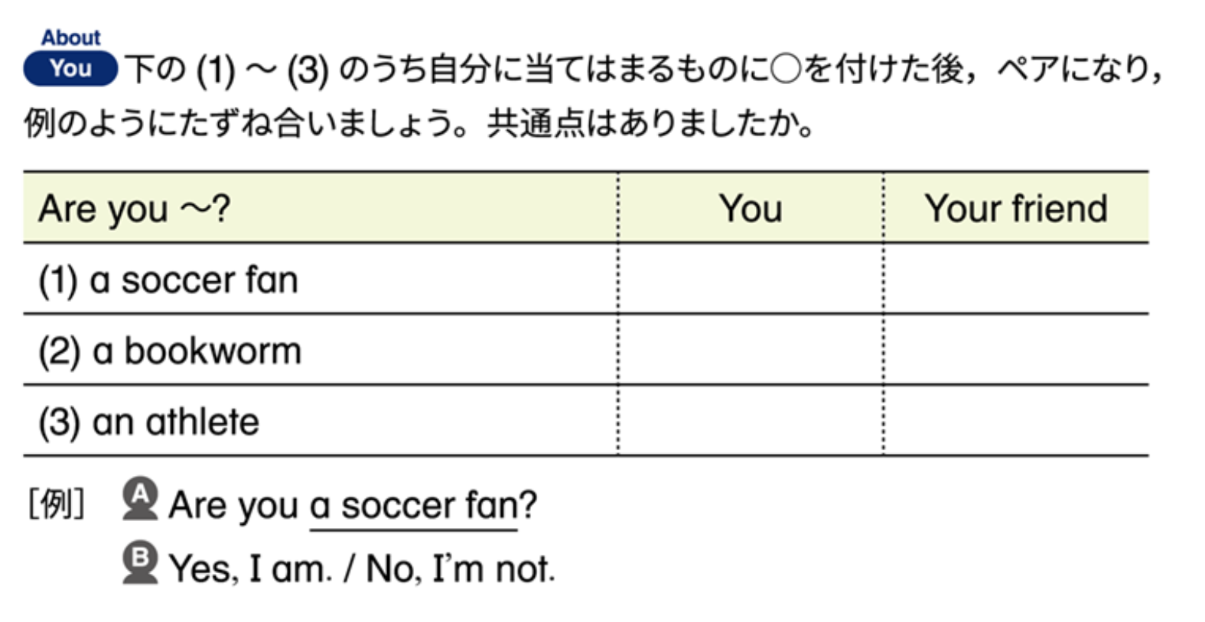
Jeopardy Questions 100
Make a sentence:
Soccer fan
Are you a soccer fan?

Slide 19
Jeopardy Questions 200
A bookworm
Are you a bookworm?

Slide 20
Jeopardy Questions 300
Make a sentence:
New students?
Are you new students?

Slide 21
Jeopardy Questions 400
Make a sentence:
On the swim team
Are you on the swim team?

Slide 22
Jeopardy Questions 500
Make a sentence:
In the brass band
Are you in the brass band?

Slide 23
Jeopardy Japanese to English 100
あなたは書くことができますか？
Can you draw?

Slide 24
Jeopardy Japanese to English 200
私の後に繰り返して
Repeat after me.

Slide 25
Jeopardy Japanese to English 300
あなたはミュージシャンですか?
Are you a musician?

Slide 26
Jeopardy Japanese to English 400
あなたは楽器を弾きますか？
Do you play an instrument?

Slide 27
Jeopardy Japanese to English 500
あなたはそれを読めますか？
Can you read it?

