Slide 1
Pusheen the Cat
Let us help Pusheen decide what to do!

Slide 2
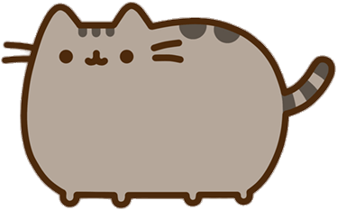
Do you remember Pusheen? Let’s help her today! She has a big test tomorrow. But, she doesn’t want to study. What should Pusheen do?
Has Pusheen checked her cell phone yet?
Has Pusheen opened her textbook yet?

Slide 3
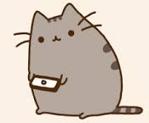
Pusheen looks at her cell phone. She can do so many things. She sees some messages from her friends. But, she hasn’t played any video games today.
Pusheen should check her messages.
Let’s play video games!

Slide 4
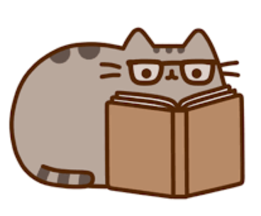
She should start studying. Pusheen looks for her textbook in her bag. It’s not there! What should Pusheen do next?
She should call her friend.
She should go to school to find her textbook.

Slide 5
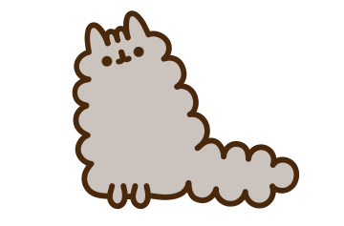
Pusheen checks her messages. There is a message from Stormy! “Have you started studying yet?” What should Pusheen say?
“Yes, I have already studied.”
“No, I haven’t studied yet.”

Slide 6
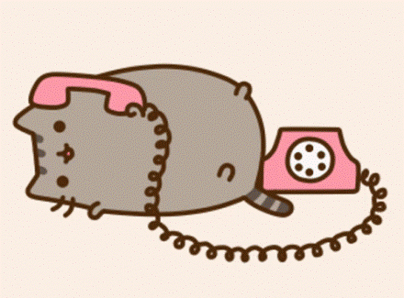
Pusheen calls her friend Sloth. Sloth tells Pusheen that he can help Pusheen study. Should she go to Sloth’s house?
No, Pusheen can use her notes.
Yes, Pusheen should go to Sloth’s house.

Slide 7
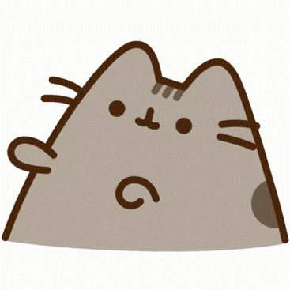
Pusheen goes to school to find her textbook. While she’s there, she sees her English teacher. Should she ask her teacher where her textbook is?
“Have you seen my textbook?”
Pusheen shouldn’t ask.

Slide 8
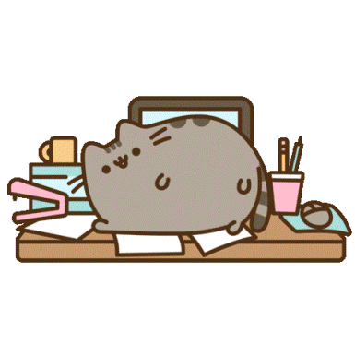
Pusheen tells Stormy that she hasn’t studied. Stormy says that they should study together! Should Pusheen go to Stormy’s house?
“Yes, I’ll go to your house!”
“No, I want to stay home.”

Slide 9
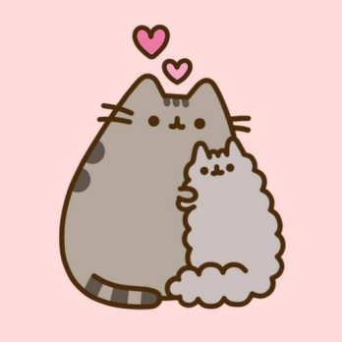
Pusheen goes to Stormy’s house. Stormy and Pusheen study together. They help each other. Pusheen and Stormy understand the textbook much better now!
Now, they should watch a movie to relax.
They should study more.

Slide 10
Pusheen plays a game on her phone. It’s very fun! Pusheen played the game all night. She hasn’t studied for the test at all! Pusheen sleeps through the test. She gets a bad grade. The end.
Back to Start

Slide 11
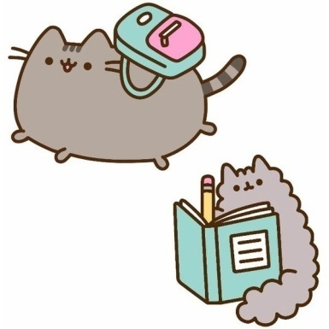
Pusheen tells Stormy that she has already studied. Pusheen lied! The next day, Pusheen sees Stormy studying for the text at school. Stormy doesn’t understand her notes! Pusheen tries to help Stormy before the test, but feels bad about lying. Stormy gets a bad grade. The end.
Back to Start

Slide 12
Pusheen uses her notes to study. Her notes are not very good. Pusheen is worried about the test. When she takes the test, she understands some of the questions. She gets an OK grade. The end.
Back to Start

Slide 13
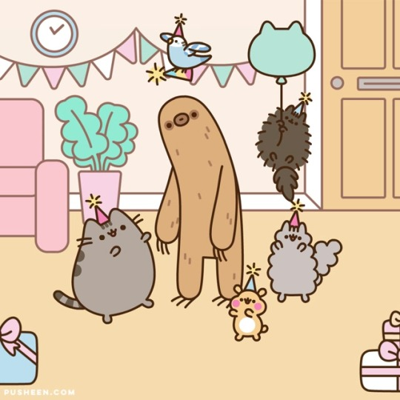
Pusheen goes to Sloth’s house. Sloth lets Pusheen use his textbook. But, Sloth is bored. Sloth asks more friends to visit his house. They have a party. Pusheen hasn’t studied much, but had fun at the party. The end.
Back to Start

Slide 14
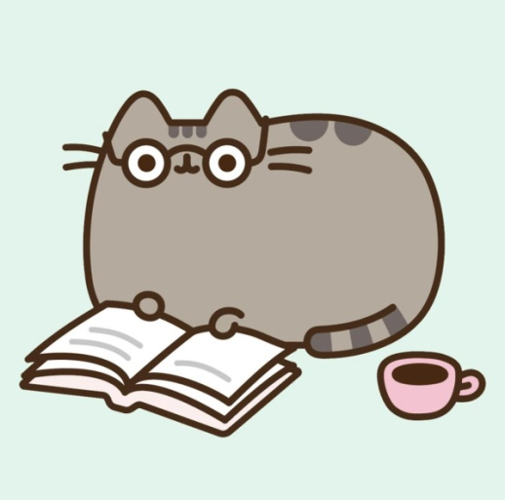
Pusheen asks her teacher, “Have you seen my textbook?” The teacher has seen Pusheen’s textbook! Pusheen asked some questions about the test. Because of the teacher, Pusheen is ready for her test! She gets 100% on her test. The end.
Back to Start

Slide 15
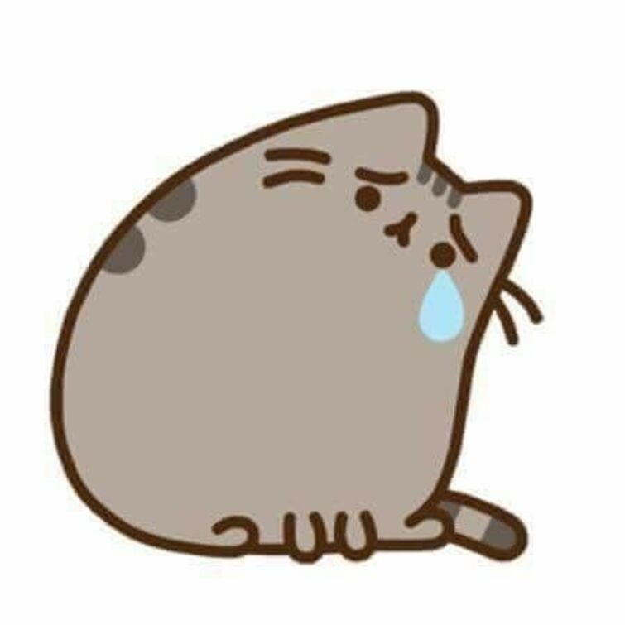
Pusheen doesn’t talk to her teacher. She looks for her textbook, but never finds it. Because she was at school for a long time, Pusheen missed the last train. She has to walk home. Pusheen didn’t have time to study. She gets a bad grade. The end.
Back to Start

Slide 16
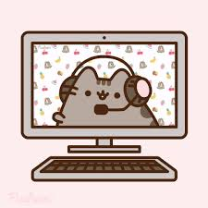
Pusheen doesn’t go to Stormy’s house. Instead, Pusheen and Stormy study on a video call. They have fun talking, but they don’t study very much. They get an OK grade on the test. Pusheen should have studied more. The end.
Back to Start

Slide 17
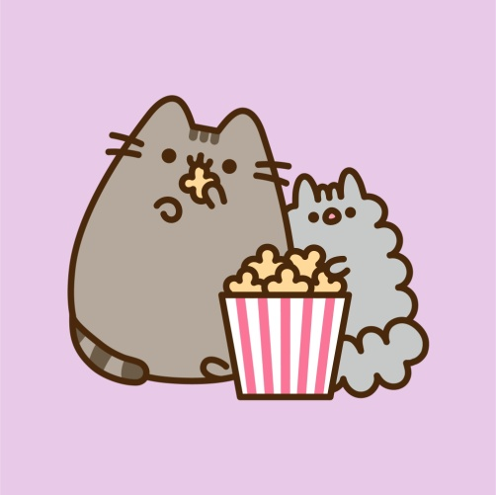
Stormy and Pusheen watch a movie. The movie was very exciting! They enjoyed watching it. Because Pusheen relaxed before her test, she was not nervous. She got 100% on her test! The end.
Back to Start

Slide 18
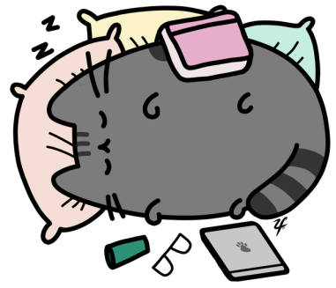
Stormy and Pusheen study all night. They were very sleepy. Pusheen didn’t hear her alarm in the morning. Pusheen overslept! She missed her test. The end.
Back to Start

