Slide 1
Notes:
Make groups of 3-5. Play rock paper scissors!

Slide 2
How to play! 遊び方

Slide 3
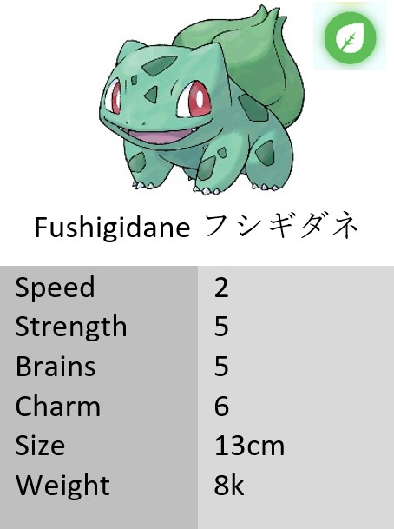
①
生徒
Notes:
Each group starts with three cards (two pokemon cards, one “pokeball card”),

Slide 4
Fushigidane
smarter than Achamo
Games are more fun than textbooks.
Notes:
they turn them over and have to write a sentence comparing the two pokemon, and then a sentence using the word on the “pokeball card” (any topic).

Slide 5
Check, please!
Nice!
①
生徒
先生
Notes:
Once they finish, one student can take their worksheet + a pokemon they don’t want to the JTE or ALT. If their sentences were okay…

Slide 6
①
生徒
Notes:
they can discard the pokemon and take two new pokemon and one new “pokeball card”
[So they have to make choices, and their deck grows little by little.]

Slide 7
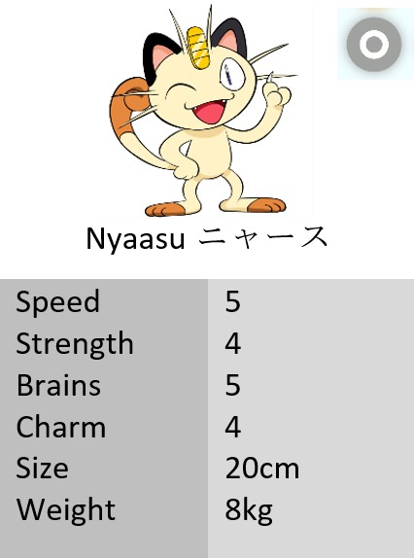
⚂
⚄
Notes:
OR their other option is to trade. If they roll the dice and get 4/5/6 they can force a trade with another team. (I didn’t get to try this bc of social distancing)

Slide 8
EVERYone writes EVERYthing EVERY time. 必ず毎回全員は全部を書くこと。
1
2
3
4
Notes:
Student goes back to the group, then the next student will be the one to get their worksheet checked by the teacher. Continue like this until the end of class.
Every student in the group has to write everything every time. Make it clear that if they only write the sentence they’re in charge of showing to the teacher, they won’t get anything. The whole group needs to write everything.

Slide 9
スコアの計算
✓
Notes:
CALCULATING SCORE. This is at the bottom of their worksheet.
Each Pokemon is one point.
If they get 3 pokemon of the same type, they get 3 extra points.
If they get a set of 6 pokemon (one of each type), they get 6 extra points.

Slide 10
✓
✓
8
1
✓
✓
✓
✓
1
1
✓
8
3
6
1
17
✓
Notes:
CALCULATING SCORE. This is at the bottom of their worksheet.
Each Pokemon is one point.
If they get 3 pokemon of the same type, they get 3 extra points.
If they get a set of 6 pokemon (one of each type), they get 6 extra points.

Slide 11
「ウワー！できなーい！」の時
???
???
✘
✘
✘
Notes:
If it’s too difficult for them to make a sentence with the “pokeball” word, they can trade it for a new word, but only three times. The worksheet has a place where the JTE/ALT can mark each time they traded.

Slide 12
Questions?
Notes:
This is just to remind yourself to check for understanding!

Slide 13
Speed: fast/slow Strength: strong Brains: smart Charm: cute/cool Size: big/small Weight: heavy/light
Notes:
Leave this slide up during play, as it will tell the students which adjectives to use for which “stat” on the Pokemon card.
During play, once one team has assembled 6 pokemon, advance to the next slide.

Slide 14
6
Notes:
Once a group has assembled a complete “team” of 6 Pokemon, they can try to catch…

Slide 15
⚂
⚄
先生
Notes:
A LEGENDARY Pokemon.
They first must discard a pokemon. If they roll 4/5/6, they can “catch” a legendary pokemon to win 5 extra points. The legendary pokemon also have a “type,” which of course contributes to their overall score.
If they fail, they can still take ONE normal pokemon card from the pile (not two).
They should STILL take a pokeBALL card, no matter what
DURING PLAY continue to the next slide to show the “stats adjectives” again.

Slide 16
Speed: fast/slow Strength: strong Brains: smart Charm: cute/cool Size: big/small Weight: heavy/light
Notes:
When you’re about 5 minutes out from the end of your time, it’s time to wrap up the game and calculate score. Go to the next slide to review how to calculate score, then go around and check they’re doing it correctly.

Slide 17
✓
✓
8
1
✓
✓
✓
✓
1
1
✓
8
3
6
1
17
✓

