Slide 1
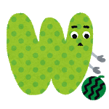
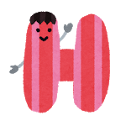
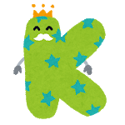
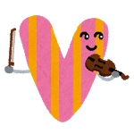
Guess the Alphabet!

Slide 2
1. What Alphabets are there?
T
H

Slide 3
2. What Alphabets are there?
P
B

Slide 4
3. What Alphabets are there?
F
E
A

Slide 5
4. What Alphabets are there?
F
H
O

Slide 6
5. What Alphabets are there?
X
T
F
K

Slide 7
6. What Alphabets are there?
Q
T
N
M

Slide 8
7. What Alphabets are there?
B
O
C
Q

Slide 9
8. What Alphabets are there?
R
S
U
I
V

Slide 10
9. What Alphabets are there?
V
A
X
W
M

Slide 11
10. What Alphabets are there?
D
Q
G
C
O
U

