Slide 1
WHERE OR WHEN QUIZ

Slide 2
EXAMPLE

Slide 3
Where or When
____ do you ____ tennis?
Where do you play tennis?
I play it at school.
3
2
2
2
A
B
C
D
E
1
1
F
5
2
3
G
H
I

Slide 4
ARE YOU READY?

Slide 5
#1
____ do you ____ lunch?
When do you eat lunch?
I eat it at 12:50.
3
2
3
1
A
B
C
D
E
F
5
4
2
5
3
G
H
I

Slide 6
#2
____ do you ____ TV?
Where do you watch TV?
I watch it at home.
1
4
3
3
A
B
C
D
E
F
1
2
5
3
4
G
H
I

Slide 7
#3
____ do you ____ English?
Where do you study English?
I study it in my room.
1
4
3
3
A
B
C
D
E
F
1
2
5
3
4
G
H
I

Slide 8
#4
before = 前
after = 後
____ do you ____ the school?
When do you clean the school?
I clean it after lunch.
2
5
2
4
A
B
C
D
E
F
1
3
3
4
2
G
H
I

Slide 9
LEVEL UP

Slide 10
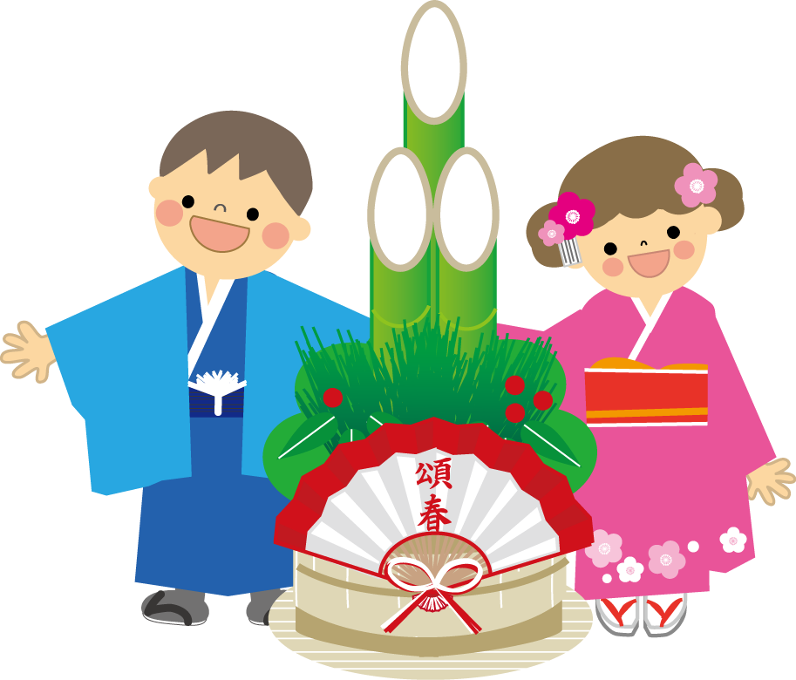
#5
____ do you ____ _____?
When do you get money?
I get ____ on New Years Day.
I get money on New Years Day.
1
3
2
5
A
B
C
D
E
F
4
1
4
2
3
G
H
I

Slide 11
#6
____ do you ____ _____?
Where do you see koalas?
I ___ koalas in Australia.
I see koalas in Australia.
2
5
5
3
A
B
C
D
E
F
1
2
1
4
1
G
H
I

Slide 12
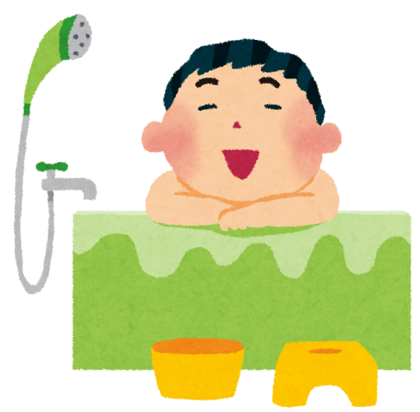
#7
____ do you ____ _____?
When do you take a bath?
I ___ a bath after dinner.
I take a bath after dinner.
2
4
5
3
A
B
C
D
E
F
3
1
1
5
2
I
G
H

Slide 13
LAST

Slide 14
#8
____ do you ____ _____?
When do you go to festivals?
I ___ to festivals in the summer.
I go to festivals in the summer.
2
4
5
3
A
B
C
D
E
F
3
1
2
1
4
G
H
I

Slide 15
THE END

