Slide 1
Unit 3
What do you want to study?

Slide 2
I want to study...
1 | 2 | 3 | 4 | 5

Slide 3
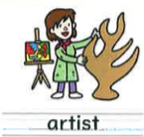
What do I want to be？ Can you guess?

Slide 4
I want to be an artist.

Slide 5
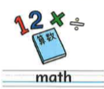
I want to study...
1 | 2 | 3 | 4 | 5

Slide 6
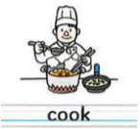
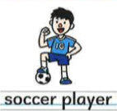
What do I want to be？ Can you guess?

Slide 7
I want to be a scientist.

Slide 8
I want to study...
1 | 2 | 3 | 4 | 5

Slide 9
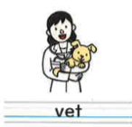
What do I want to be？ Can you guess?

Slide 10
I want to be a musician.

Slide 11
I want to study...
1 | 2 | 3 | 4 | 5

Slide 12
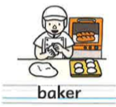
What do I want to be？ Can you guess?

Slide 13
I want to be a baker．

