Slide 1
If I met ...

Slide 2
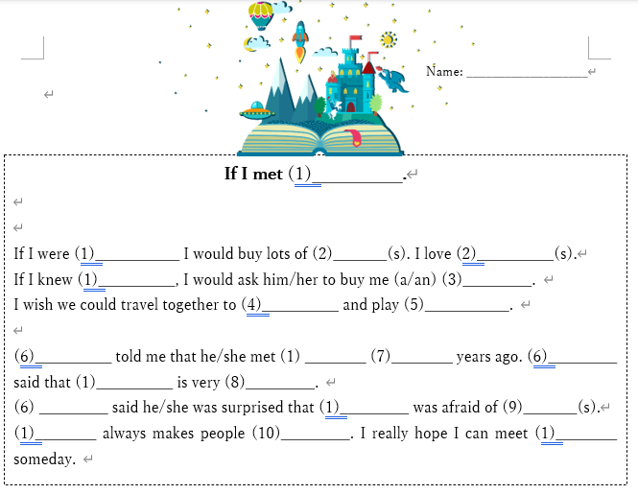

Slide 3
If I were (1)____ I would buy lots of (2)_____.

Slide 4
I love (2)__________(s).

Slide 5
If I knew (1)__________, I would ask him/her to buy me (a/an) (3)_________.

Slide 6
I wish we could travel together to (4)__________ and play (5)___________.

Slide 7
(6)__________ told me that he/she met (1) ________ (7)________ years ago.

Slide 8
(6)_________ said that (1)__________ is very (8)_________.

Slide 9
(6) _________ said he/she was surprised that (1)_________ was afraid of (9)_______(s).

Slide 10
(1)________ always makes people (10)_________.

Slide 11
I really hope I can meet (1)________ someday.

