Slide 1
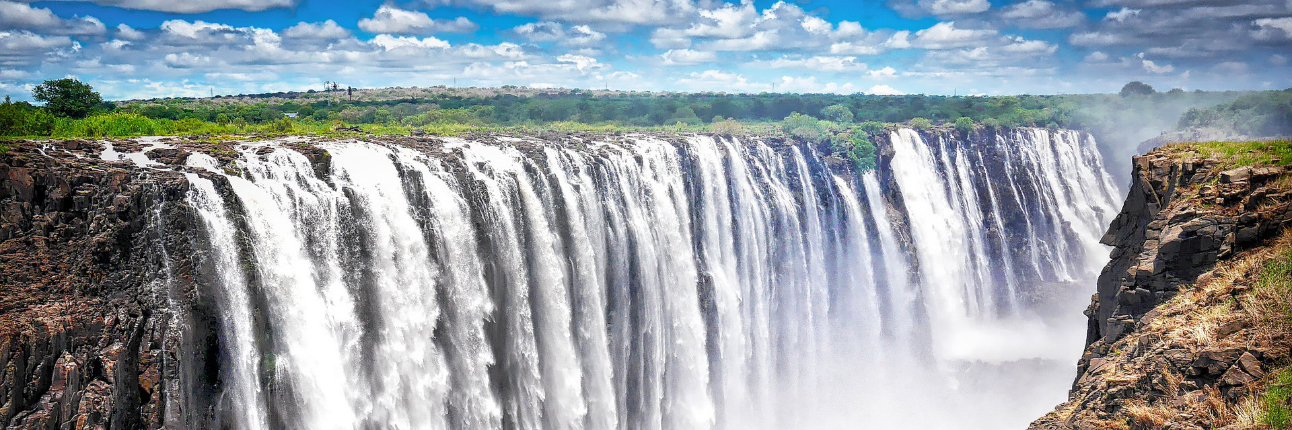
Idea 1: A Good Memory (行ったことがある所)
I have been to Zimbabwe in Africa four times with my family. I went there when I was six, ten, fifteen, and twenty years old. My grandmother has lived in Zimbabwe since she was born, so I visit her every few years.
Victoria Falls is between Zimbabwe and Zambia. It is the biggest waterfall in the world. I have been there before, but only once. It was very beautiful. Victoria Falls has been on the World Heritage List since 1989.
was born 生まれた waterfall 滝
Name __________________ Class __-__ Number ____ Date ____________
Program 2 Review
I have _______ (once/twice/three times/…).
I have _______ (for/since) ____________.
(It) has ______ (for/since) ____________.
Let’s think! (brainstorm) 考えましょう！
Place: _____________________________________________________
How many times have you been there? _____________________________
Who did you go with? _________________________________________
When did you go? ____________________________________________
Why did you go? _____________________________________________
More information: ___________________________________________
_________________________________________________________

Slide 2
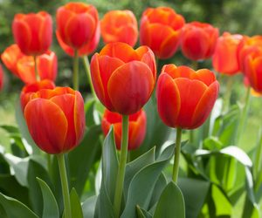
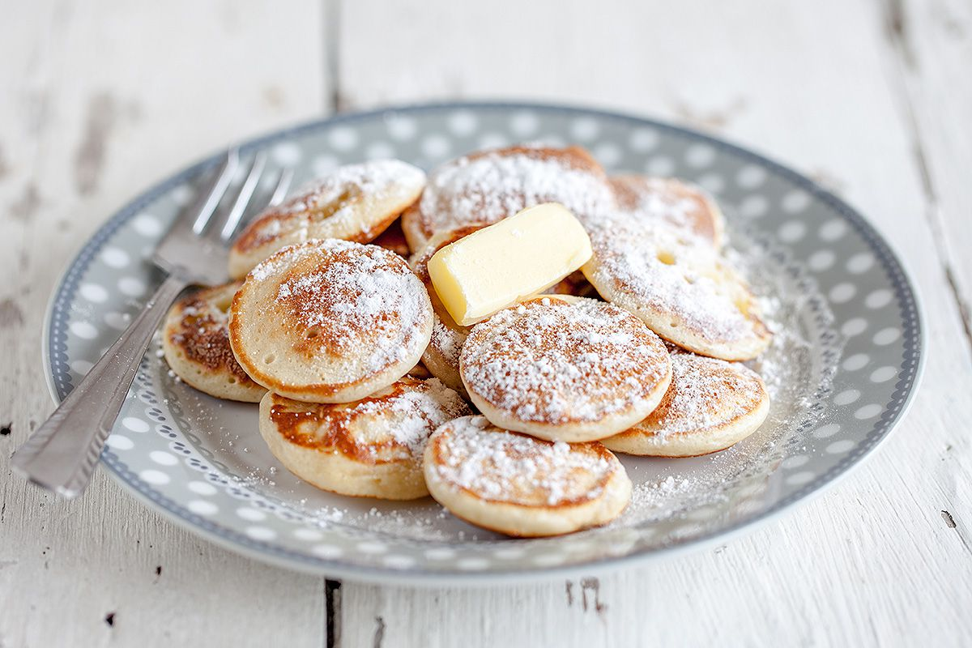
Idea 2: A New Adventure (行ったことがない所)
I want to go the Netherlands. I have never been there before. I think the Netherlands is a beautiful country. They have a lot of tulips, and I love tulips. I want to try some Dutch food such as poffertjes. Poffertjes are like mini pancakes. They look really delicious.
I have been interested in the Netherlands since I was about twelve years old because my family is Dutch. I hope to go with my family someday.
The Netherlands オランダ Dutch オランダの
tulips 鬱金香, チューリップ poffertjes ポーフェルテ
Name __________________ Class __-__ Number ____ Date ____________
Program 2 Review
I have never (been to/visited) _______.
I have (been interested in/wanted to go to) _______ (for/since) _______.
Let’s think! (brainstorm)
Place: _____________________________________________________
Who do you want to go with? ___________________________________
Why do you want to go? _______________________________________
More information: ___________________________________________
_________________________________________________________
_________________________________________________________
_________________________________________________________

Slide 3
Name __________________ Class __-__ Number ____ Date ____________
Let’s write!
_________________________________________________________
_________________________________________________________
_________________________________________________________
_________________________________________________________
_________________________________________________________
_________________________________________________________
_________________________________________________________
_________________________________________________________
_________________________________________________________
_________________________________________________________
_________________________________________________________
_________________________________________________________
_________________________________________________________
_________________________________________________________
_________________________________________________________
_________________________________________________________
_________________________________________________________
Comments

