Slide 1
Let’s play Jeopardy!
name 5
What’s the word?
animals
textbook
nazonazo
100 points
100 points
100 points
100 points
100 points
100 points
100 points
100 points
100 points
100 points
200 points
200 points
200 points
200 points
200 points
200 points
200 points
200 points
200 points
200 points
300 points
300 points
300 points
300 points
300 points
300 points
300 points
300 points
300 points
300 points
400 points
400 points
400 points
400 points
400 points
400 points
400 points
400 points
400 points
400 points
500 points
500 points
500 points
500 points
500 points
500 points
500 points
500 points
500 points
500 points

Slide 2
Name five…
animals
and get 100 points!

Slide 3
Name five…
kinds of weather
and get 200 points!

Slide 4
Name five…
sports
and get 300 points!

Slide 5
Name five…
foods
and get 400 points!

Slide 6
Name five…
countries
and get 500 points!

Slide 7
s_v_nt_ _ n
seventeen
100 points!

Slide 8
d_am _
drama
200 points!

Slide 9
bea_ _ i _ ul
beautiful
Say the word to get 300 points!

Slide 10
u_u_ll_
usually
Say the word to get 400 points!

Slide 11
T_ _ r _ _ a _
Thursday
Say the word to get 500 points!

Slide 12
I eat grass.
I make milk.
I say “moo!”
It’s a cow!
100 points!

Slide 13
I can’t fly, but I can swim.
I like the cold.
I am black and white.
It’s a penguin!
200 points!

Slide 14
I have big ears.
I have a long nose.
I live in Africa and India.
It’s an elephant!
300 points!

Slide 15
I live in the sea.
I have a big head.
I have eight arms.
It’s an octopus!
400 points!

Slide 16
I live in the woods.
I can eat a lot of fish.
I sleep during the winter.
It’s a bear!
500 points!

Slide 17
Where is Tina from?
She’s from America
(New York).
100 points

Slide 18
Eri can play the piano.
200 points

Slide 19
What is Kota’s favorite food?
rice balls
300 points

Slide 20
What do you do on weekends?
例】I usually watch TV.
400 points

Slide 21
Everyone do a self-introduction!
500 points

Slide 22
?
9, 14, 19, 24, 29, 34
100 points

Slide 23
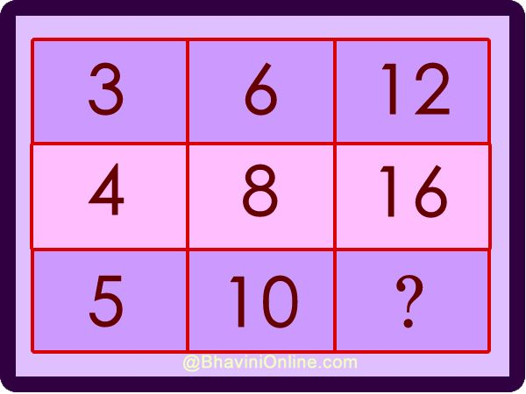
?
20
200 points

Slide 24
?
1, 4, 5, 6, 7, 9, 11
Hint: It doesn’t have a ‘T’.
300 points

Slide 25
?
7, 8, 5, 5, 3, 4, 4, 6
hint: months
400 points

Slide 26
?
16, 06, 68, 88
Hint: look at it a different way.
500 points
16, 06, 68, 88

