Slide 1
Canadian Ice Cream

Slide 2
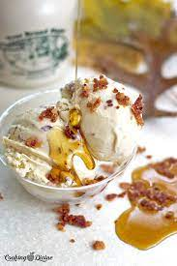
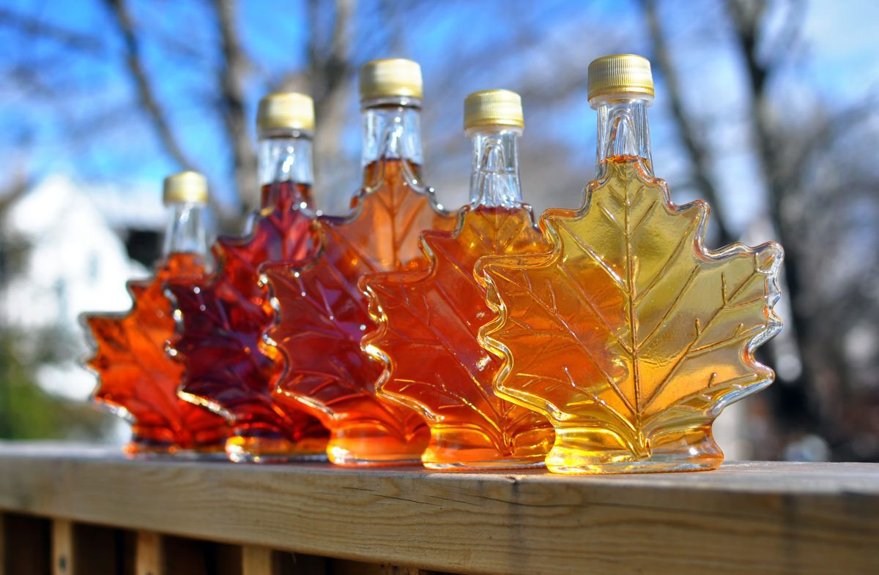
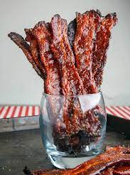
Maple Bacon Ice Cream
I suggest maple bacon as a new ice cream flavor. The bacon will be salty and the maple will be sweet. On top there will be crunchy pieces of bacon bits. Canada is famous for bacon and maple syrup. Canada has many farms and Canada makes 80% of the maple syrup for the world.

Slide 3
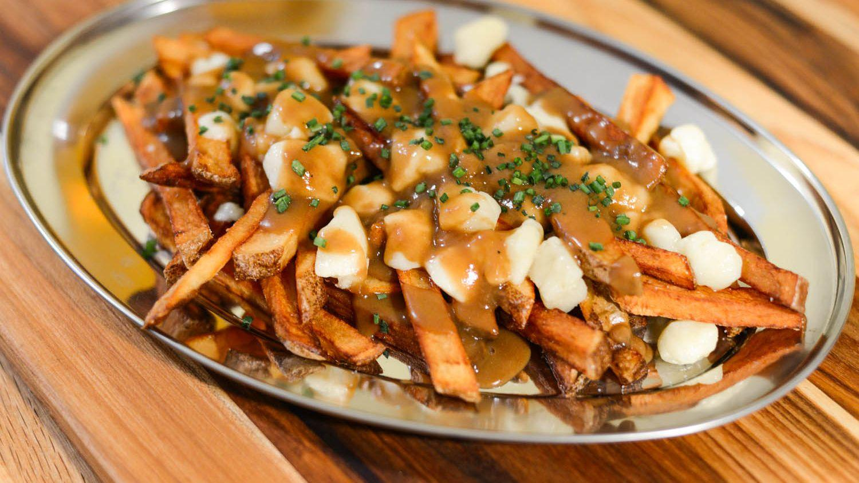
Poutine and Wildflower Honey Ice Cream
I suggest this new ice cream flavor. The ice cream is poutine flavored with pieces of cheese and the cone is made from potatoes. Then it is drizzled with poutine gravy and honey from Alberta wild flowers. Since everyone loves cheese, I am sure everyone will love this ice cream.

Slide 4
These flavors truly represent Canadian food culture.
Thank you.

