Slide 1
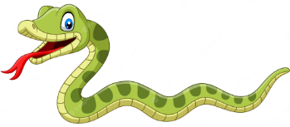
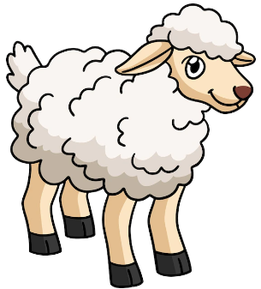
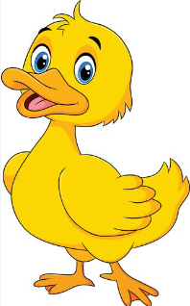
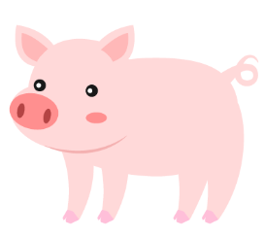
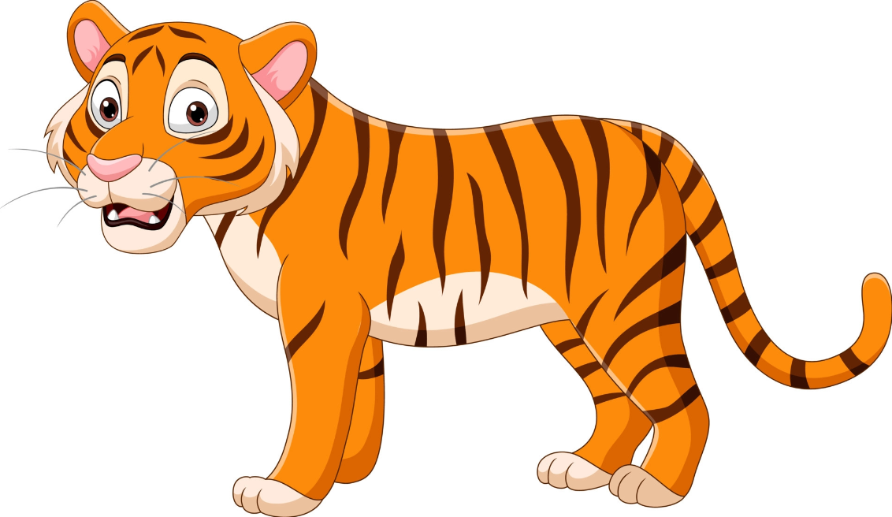
Name：＿＿＿＿＿＿＿＿＿＿＿＿＿＿
Unit 9 – Who are you?
Worksheet
I see something round and pink まるい ぴんく
I see something long and green
ながい みどり
I see something red and white
あか しろ
I see something small and yellow
小さい きいろ
I see something furry and white
けがわ しろ
I see something orange and fast
おらんげ はやい
I see something big and blue おきい あおい
whale
snake
sheep
duck
chicken
pig
tiger

