Slide 1
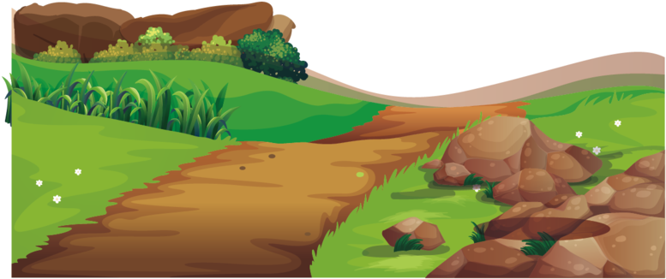
5 Minute Story Relay

Slide 2
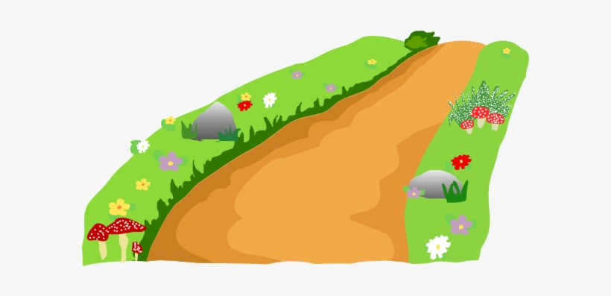
Rules
Read the first sentence on the board
Starting with the students at the front of the class, write one sentence and pass the paper to the person behind you
The next person writes a sentence, and so on, until the timer is finished
You do not need to move the desks
When everyone has had their turn (or after the timer runs out) write ‘The End’ at the bottom of the page
Read your stories to the class!

Slide 3
Example
One day an old woman saw a giant peach in the river.
She brought it home and found a boy inside.
The boy grew very strong.
He went to the Demons Island with a dog, monkey and pheasant.
He beat the demons.
The End.

Slide 4
You find ¥1 billion

Slide 5
You find a monster in your closet

Slide 6
It’s your
birthday today

Slide 7
You forget your house keys

Slide 8
You learn
how to fly

Slide 9
You discover a dragon in the mountains

Slide 10
You had
the best day ever!

Slide 11
You had
the worst day ever!

Slide 12
You become a cat

Slide 13
You grow two
extra arms

