Slide 1
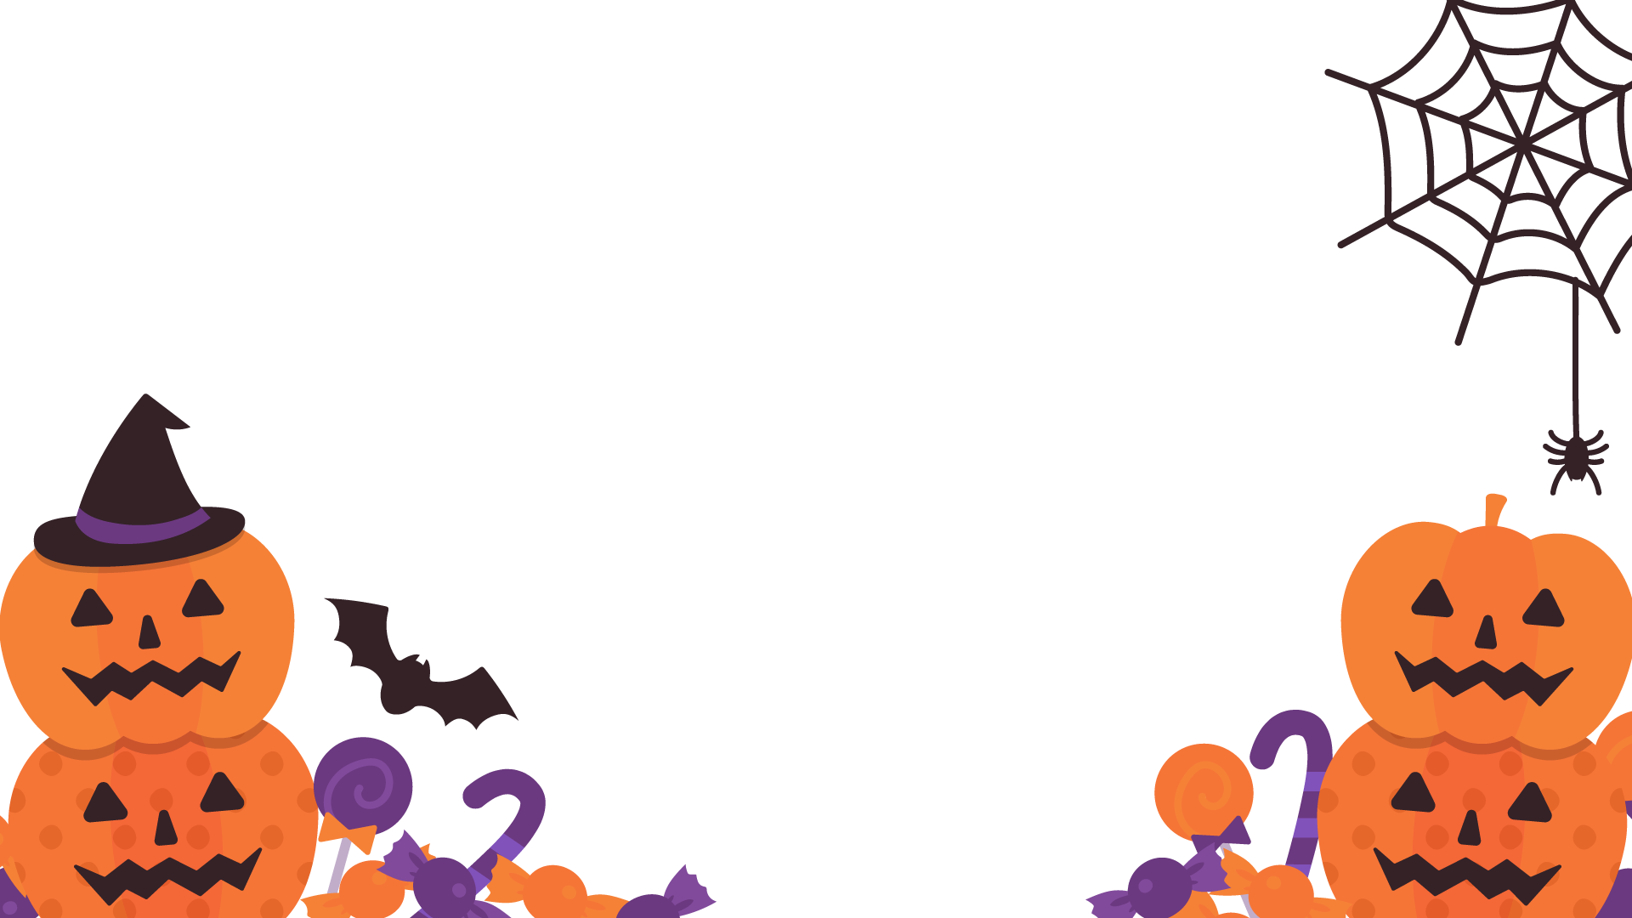
Halloween Shapes

Slide 2
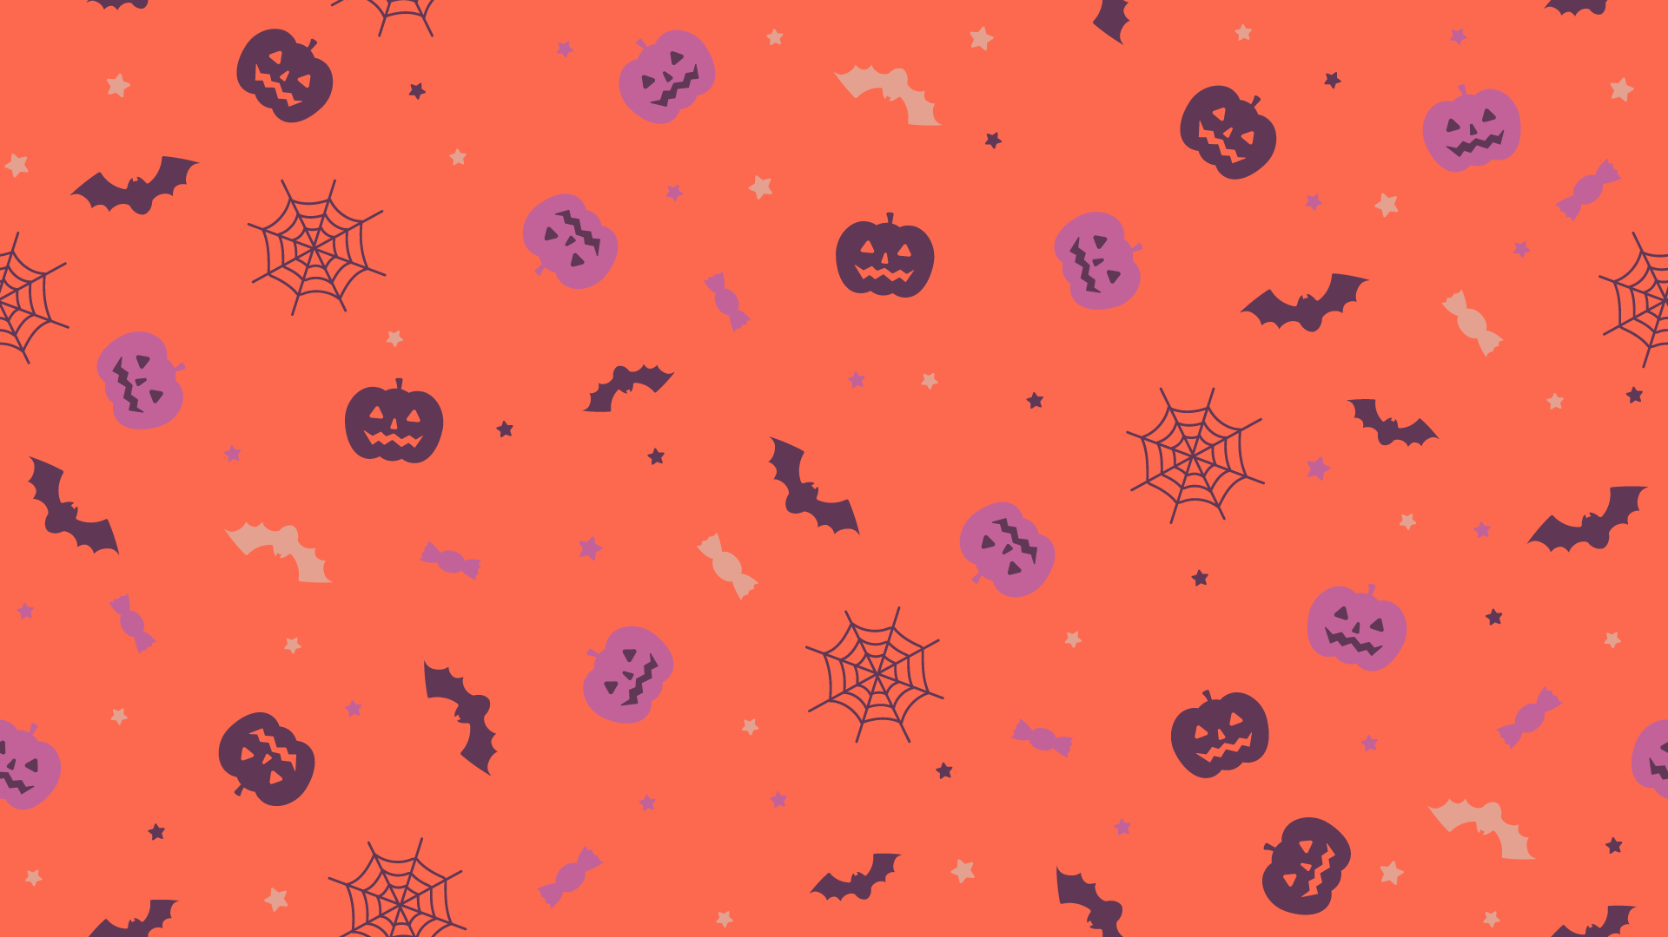
shapes

Slide 3
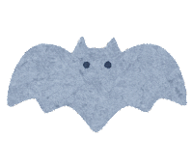
colors

Slide 4
Let’s make candy!

Slide 5
Let’s make a pumpkin!

Slide 6
Let’s make a ghost!

Slide 7
Let’s make a witch!
Last one!

Slide 8
Great job!

