Slide 1
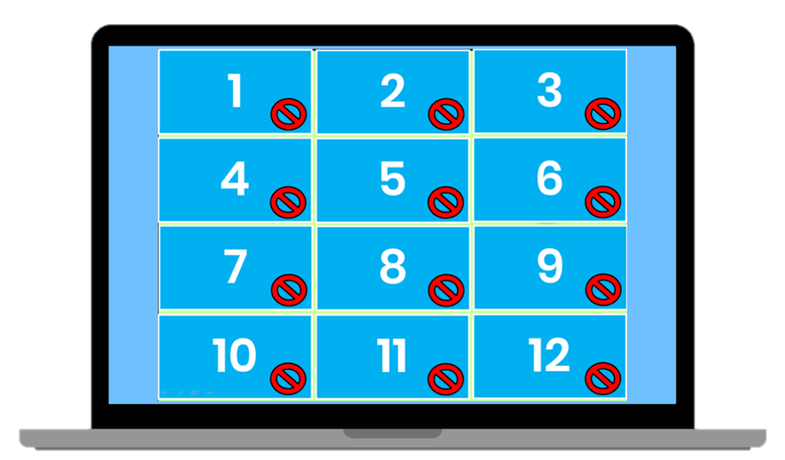
Matching Game
How to Play
Divide the class into two teams. Each team then takes turns in choosing TWO squares. If the two squares are the same word / picture, then the team gets a point. If the two squares are different, then click on the red circle to hide the picture again. Students must try to remember where the matching pairs of words are.

Slide 2
2
December | May | 3月 | 11月 | October | 9月
1月 | November | June | 4月 | 5月 | February
August | 7月 | April | January | 6月 | 2月
March | September | 8月 | 12月 | July | 10月
1
3
4
5
6
7
8
9
10
11
12
13
14
15
16
17
18
19
20
21
22
23
24

