Slide 1
superman
_uperman

Slide 2
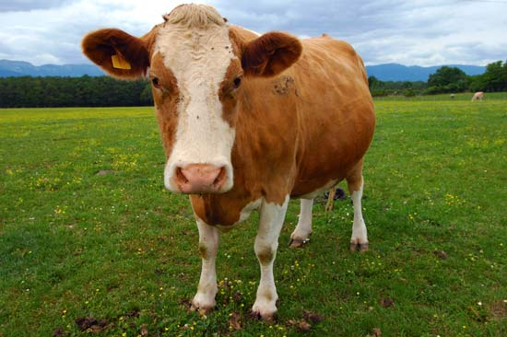
cow
_ow

Slide 3
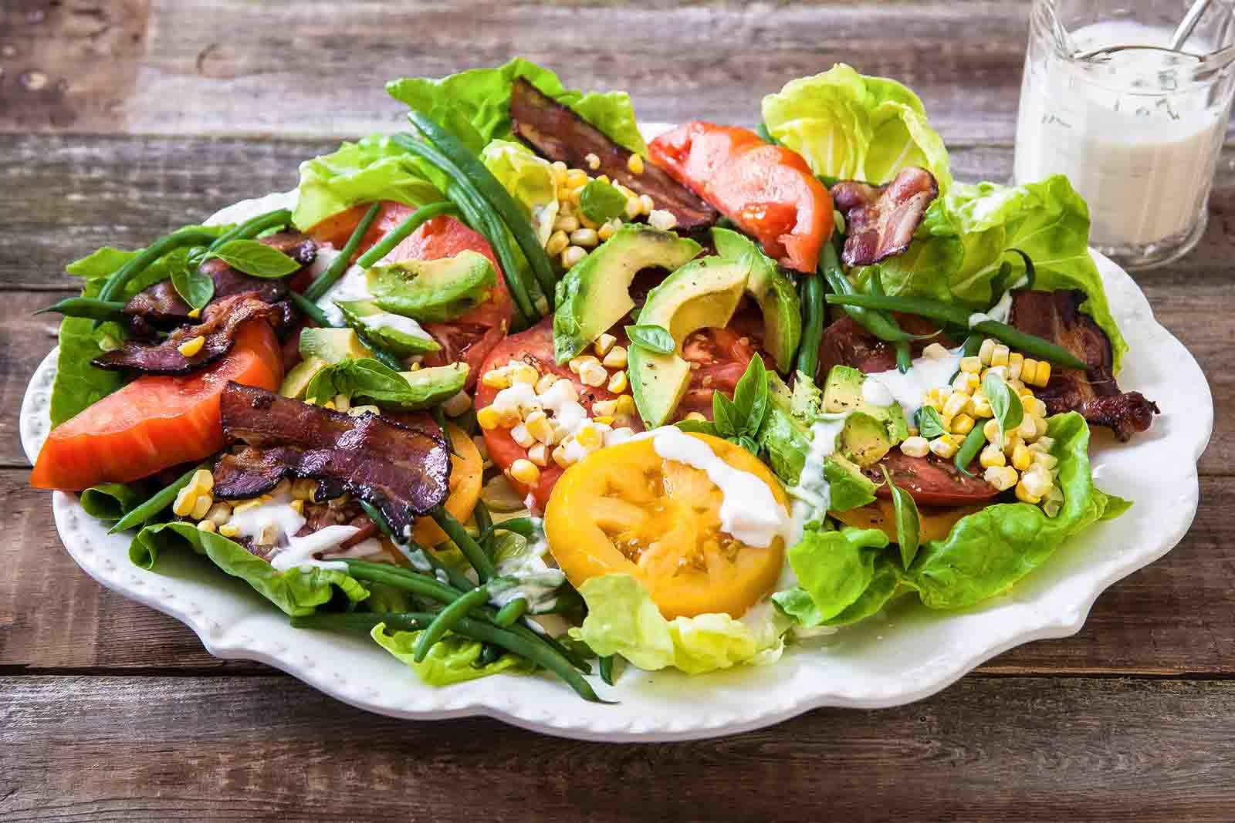
salad
_alad

Slide 4
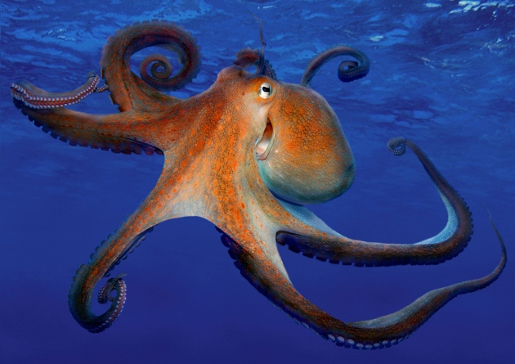
octopus
_ctopus

Slide 5
And last…

Slide 6
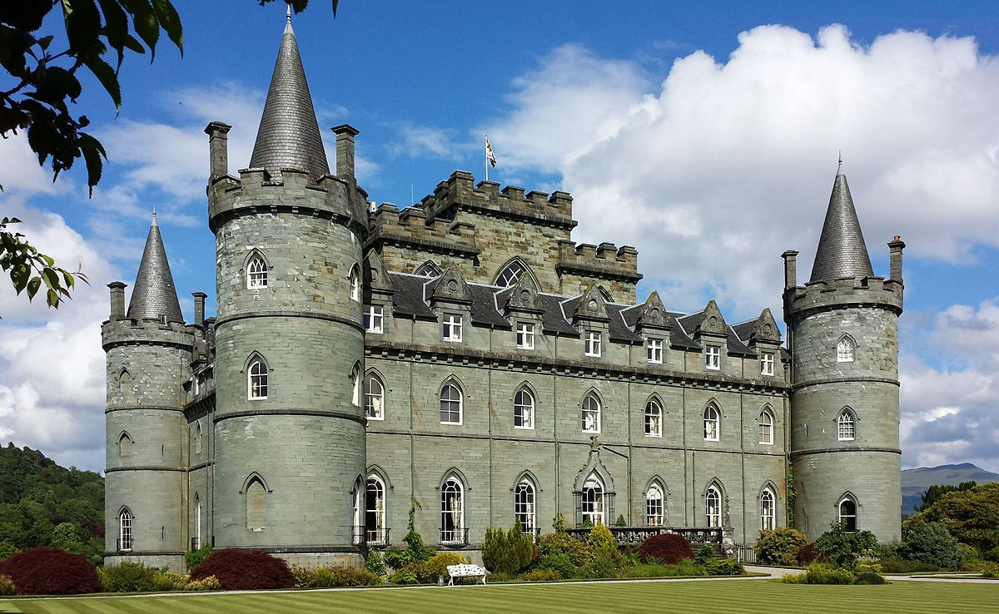
_astle
castle

