Slide 1
Class: Number: Name:
Let’s compare! Which is best?
In pairs, let’s talk and write about our opinions! For each question, we will follow three steps!
Write by yourself 2. Talk in pairs 3. Tell your answer to the class!
OO is/are better than OO because________.
Ex: Vegetables are better than fruit because they are cheap.
1. Do you like cats or dogs better? Why?
2. Do you like manga or anime better? Why?
3. Do you like ramen or curry better? Why?
OO is/are the best because________.
Ex: BTS is the best because they are famous!
4.What is your favorite movie? Why?
5. Which sport is the best? Why?

Slide 2
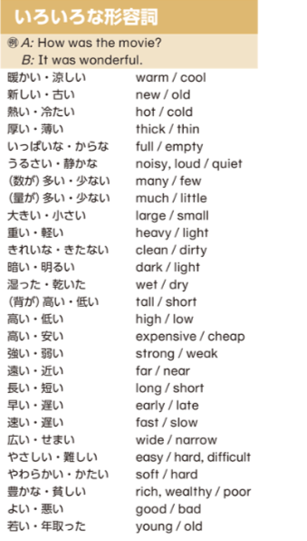
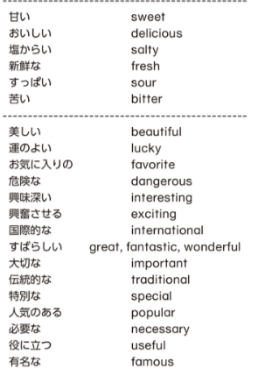
6. Where is the best place to travel? Why?
7. What is the best snack? Why?

