Slide 1
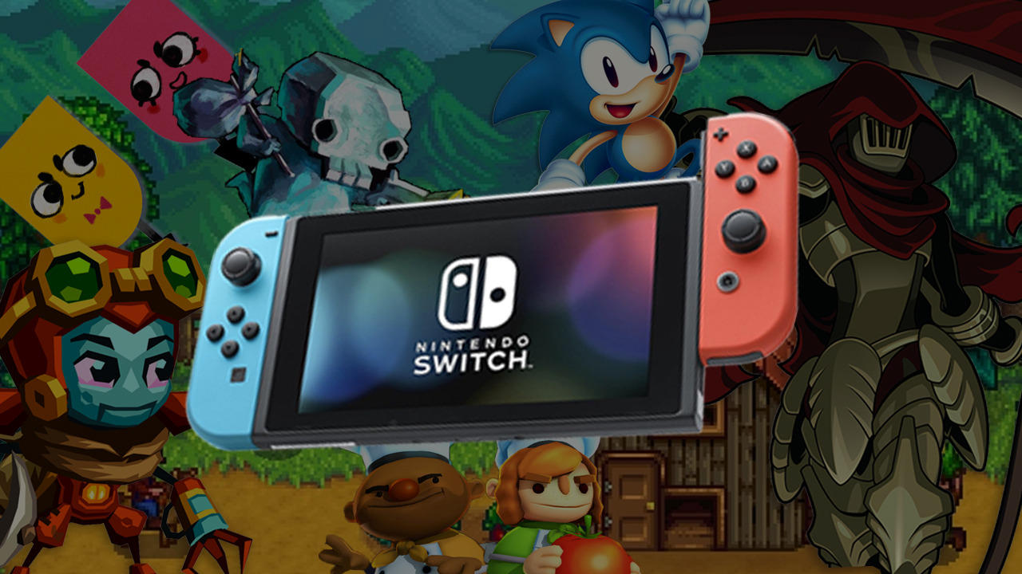
games
_ames

Slide 2
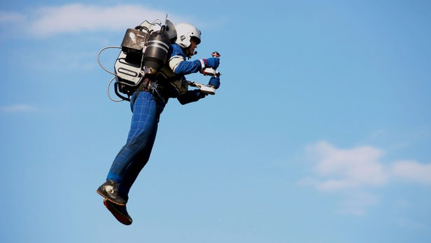
jetpack
_etpack

Slide 3
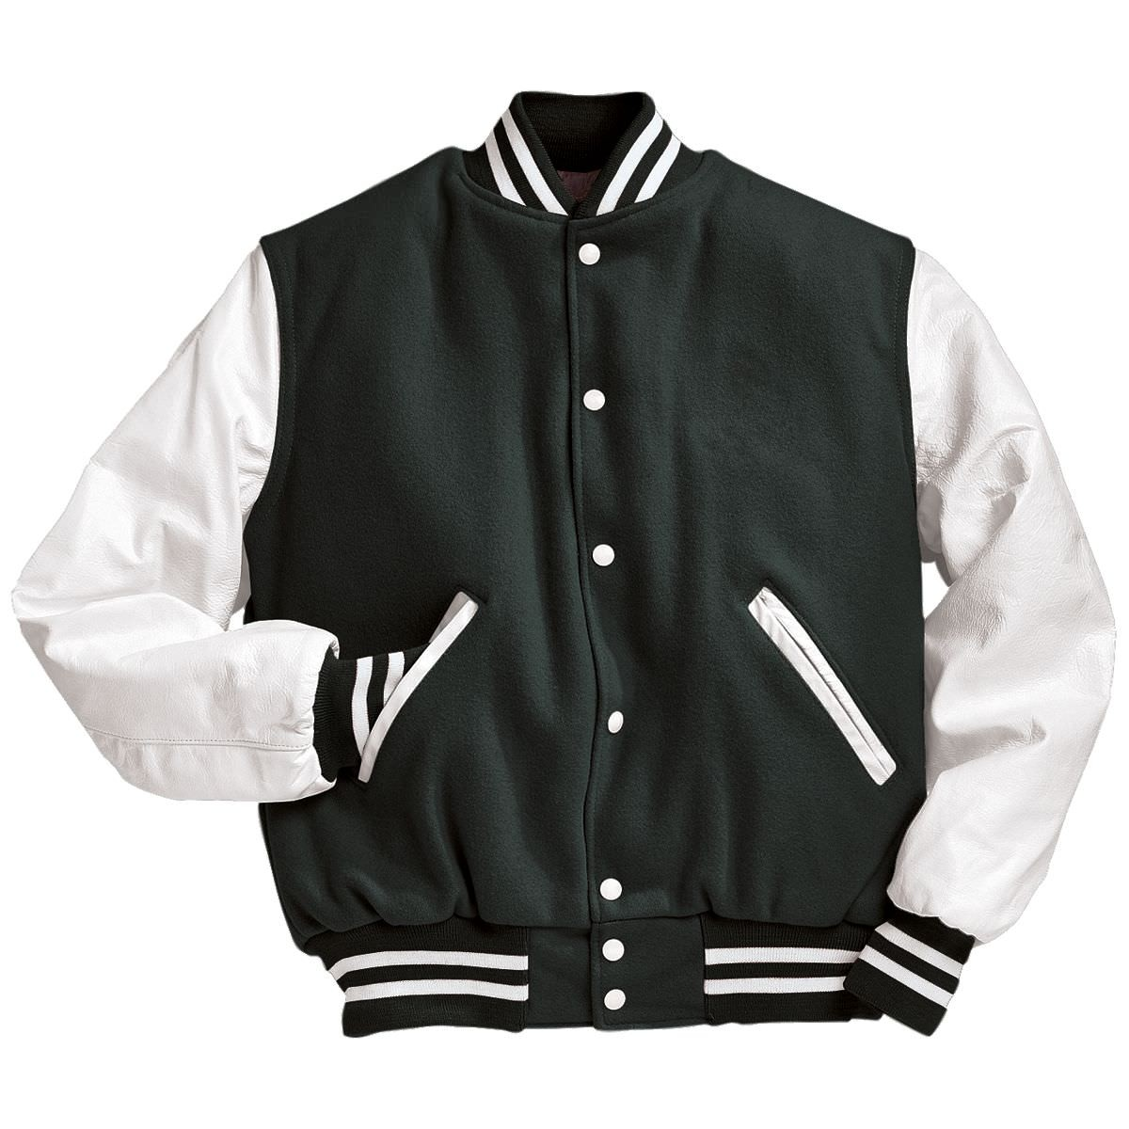
jacket
_acket

Slide 4
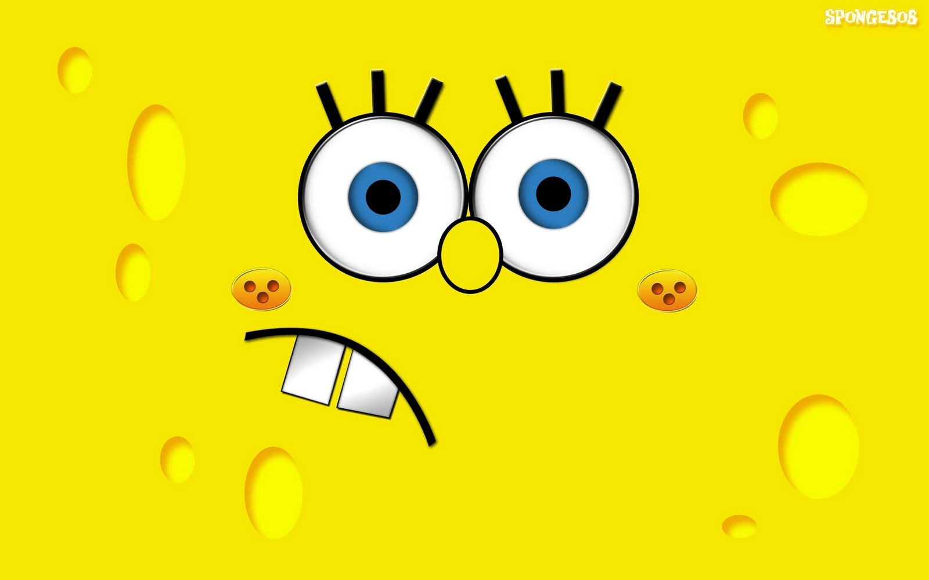
yellow
_ellow

Slide 5
And last…

Slide 6
_ host
ghost

