Slide 1
question
_uestion

Slide 2
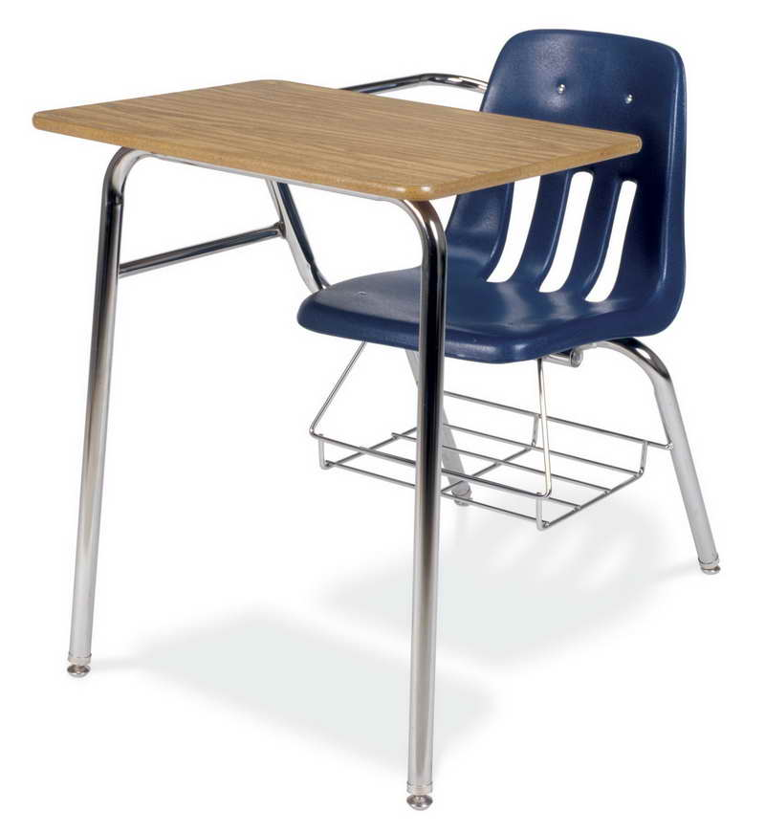
desk
_esk

Slide 3
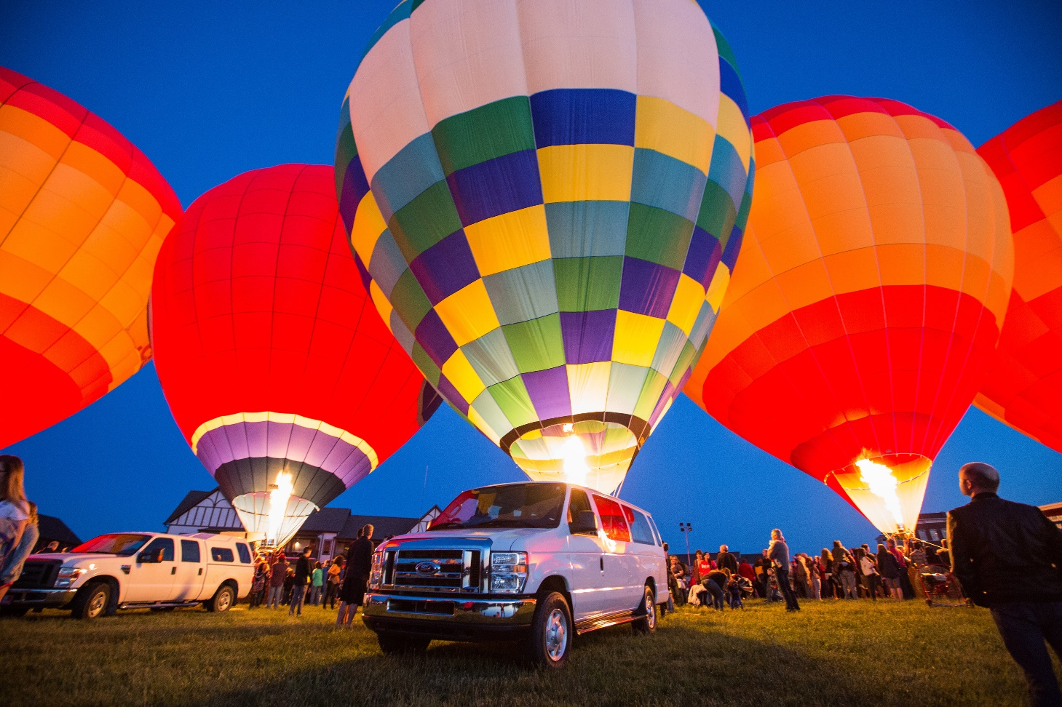
balloon
_alloon

Slide 4
pineaple
_ineapple

Slide 5
And last…

Slide 6
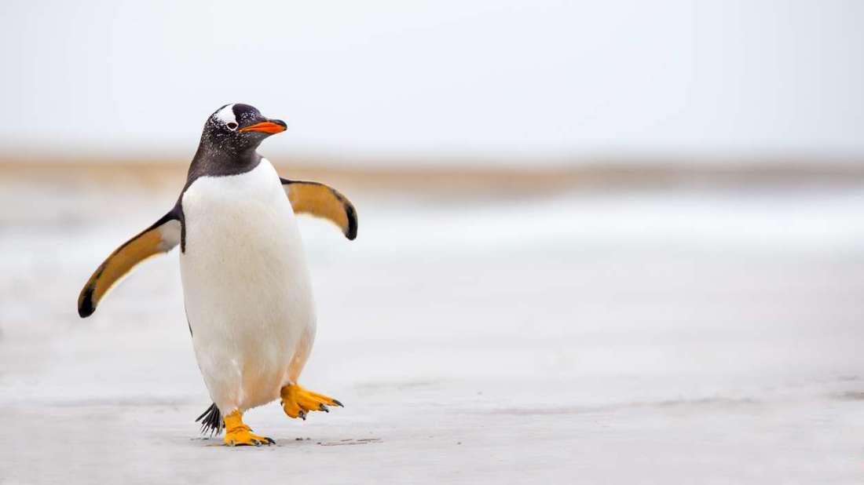
_ enguin
penguin

