Slide 1
HAPPINESS IS…
SOMETHING TO DO!
SOMEPLACE TO GO!
SOMEONE TO LOVE!

Slide 2
ONE

Slide 3
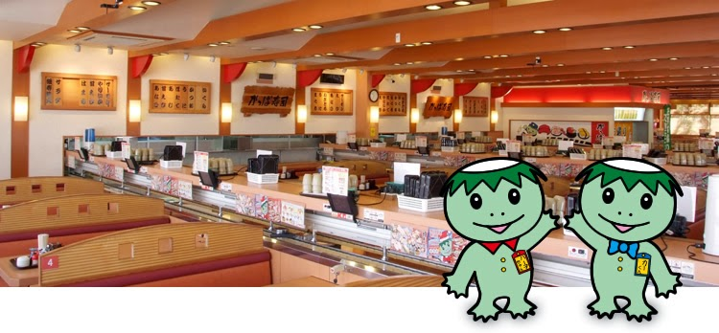
What is something to eat at Kappazushi?
_____ is something to eat at Kappazushi.
Sushi is something to eat at Kappazushi.

Slide 4
TWO

Slide 5
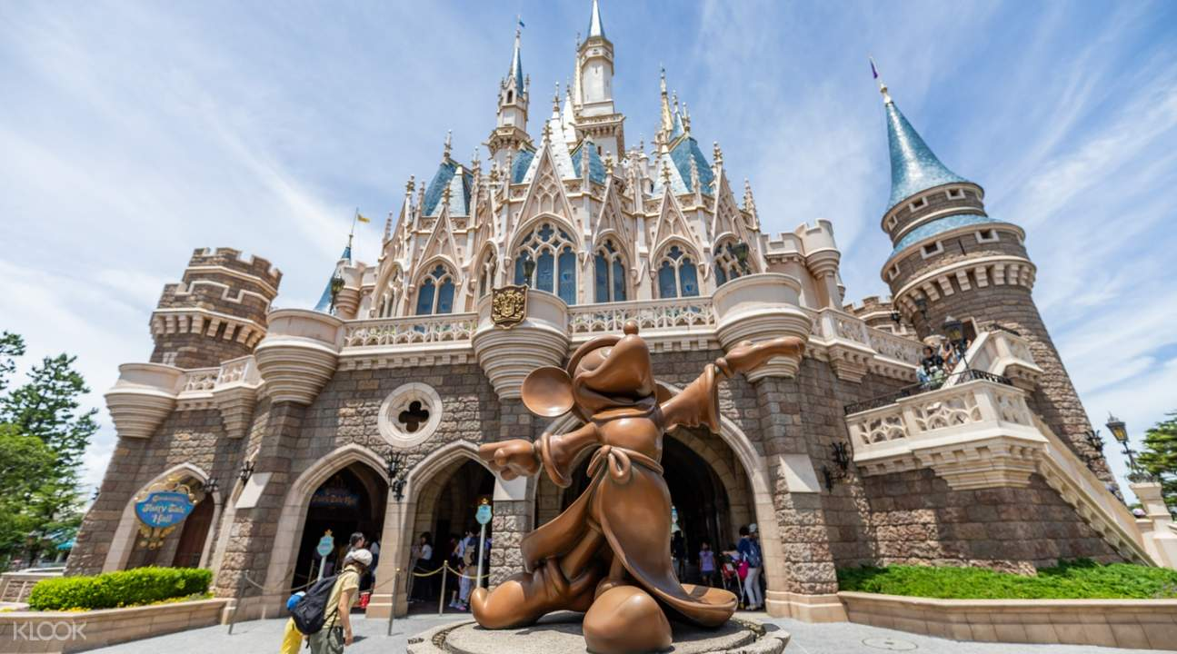
Who is someone to meet at Disneyland?
_____ is someone to ___ at Disneyland.
Mickey is someone to meet at Disneyland.

Slide 6
LAST

Slide 7
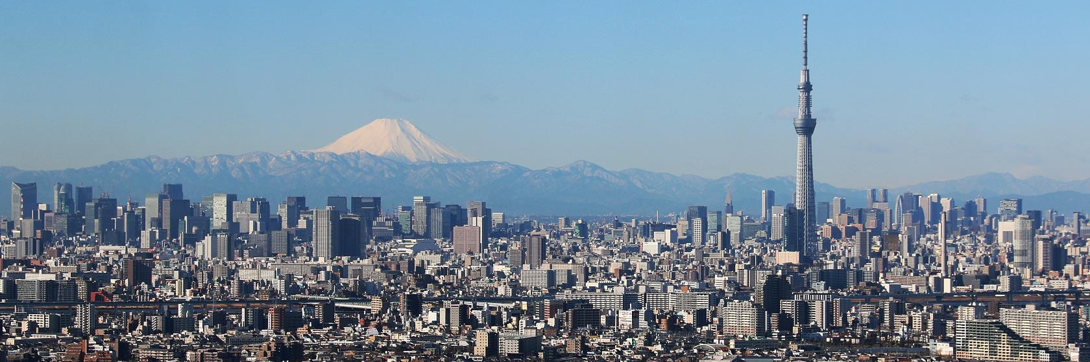
Where is someplace to visit in Tokyo?
_____ is someplace to ___ in ____.
The Sky Tree is someplace to visit in Tokyo.

Slide 8
NEXT…
WRITING TIME

