Slide 1
You must-
You must not-
SIGNS!!!
Robert Rosehart

Slide 2
例
You must stop
You must ____.

Slide 3
#1
You must not smoke.
You must not___.

Slide 4
#2
You must not eat or drink.
You must not ___ or ____.

Slide 5
#3
You must drive slow.
You must ___ slow.

Slide 6
#4
You must not touch.
You must not ____.

Slide 7
#5
You must be quiet.
You must not talk.
You must be ____.

Slide 8
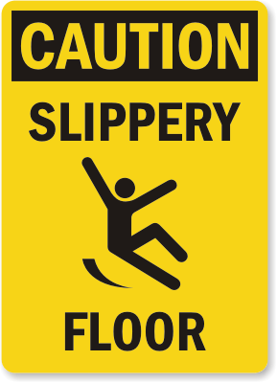
#6
You must not run.
You must not ____.

Slide 9
#7
You must use a seatbelt.
You must ___ a ____.

Slide 10
#8
You must not take pictures.
You must not ___ ____.

Slide 11
The End!
Good Job!!!

