Slide 1
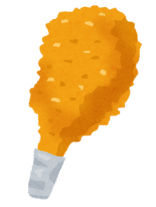
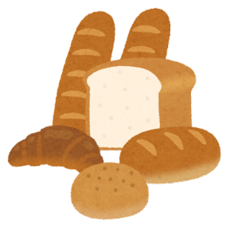
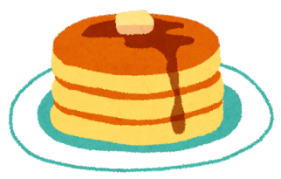
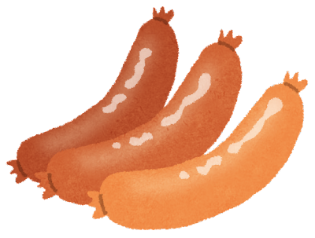
What would you like?
fried chicken
480yen
120yen
hamburger
pancakes
bread
300yen
140yen
270yen
560yen
sausage
cake

Slide 2
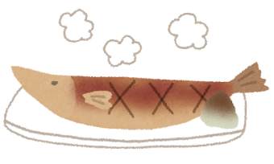
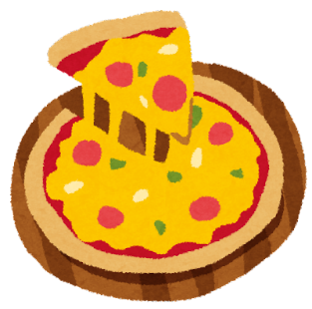
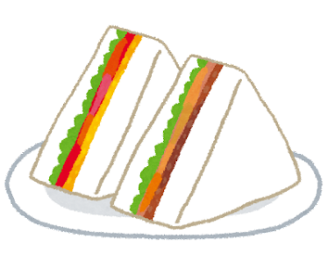
What would you like?
French fries
630yen
130yen
grilled fish
hot dog
rice ball
410yen
150yen
590yen
200yen
pizza
sandwich

