Slide 1
HOW TO PLAY
Let’s listen to the rules!

Slide 2
STEP ONE
Winner asks question first.

Slide 3
FOR EXAMPLE:
MS. KAYAMA WINS!

Slide 4
FOR EXAMPLE:
Ms. D, if you have time, what will you do?
If I have time, I will play baseball.

Slide 5
FOR EXAMPLE:
MS. KAYAMA’S SHEET
Danielle
Partner will sign their name!

Slide 6
Then, change roles!
Ms. Kayama, if you go to McDonald’s, what will you buy?
Hmm, if I go to McDonald’s, I will buy some french fries.

Slide 7
FOR EXAMPLE:
MS. D’S SHEET
Kayama
Partner will sign their name!

Slide 8
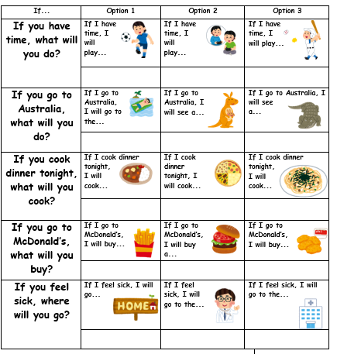
THE GOAL:
Kayama
Neko
Jerry
Umi
Sam
Yuna
Keishin
Kaito
Sally
Jensukie
Danielle
Yui
Yota
Yuta
Sora

