Slide 1
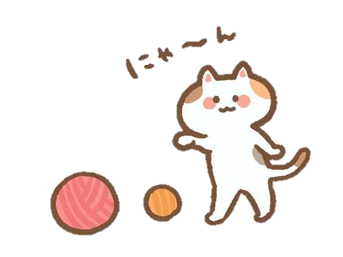
Animal Sounds Quiz
What sounds do animals make in English?

Slide 2
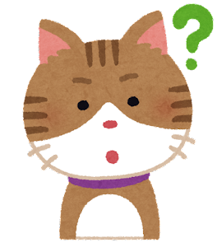
Bow wow!

Slide 3
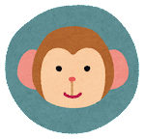
Oink, oink!

Slide 4
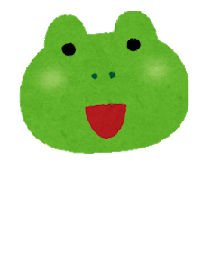
Squeak, squeak!

Slide 5
Ribbit!

Slide 6
Woof!

Slide 7
Baa, baa!

Slide 8
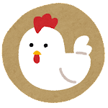
Chirp, chirp!

Slide 9
Quack, quack!

Slide 10
Cock-a- doodle- doo!

Slide 11
Ooh ooh ah ah!

