Slide 1
Word search

Slide 2
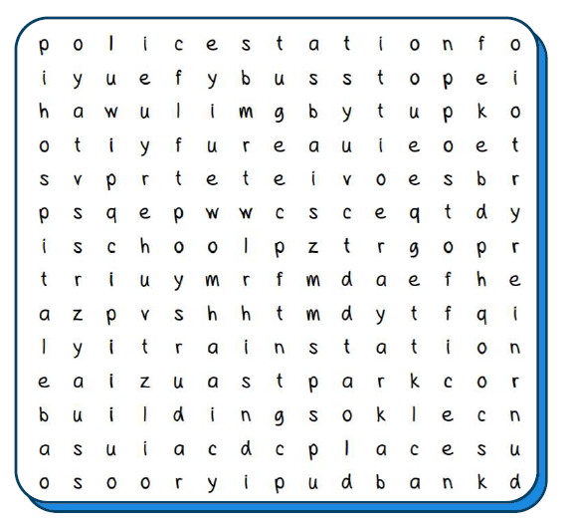
hospital
bank
school
park
train station
bus stop
airport
fire station
police station
post office
buildings
places

Slide 3
hospital
bank
school
park
train station
bus stop
airport
fire station
police station
post office
buildings
places

