Slide 1
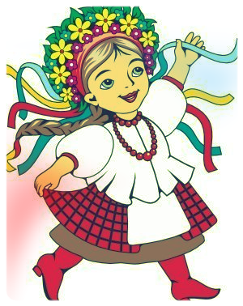
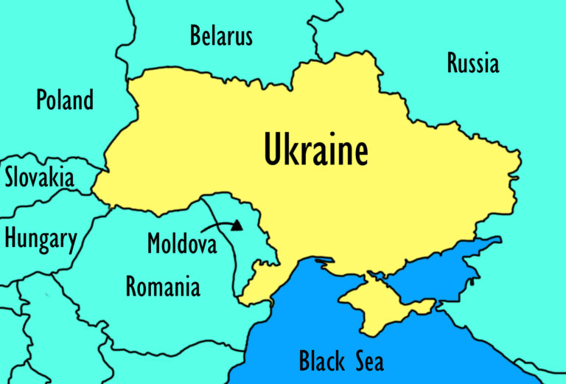
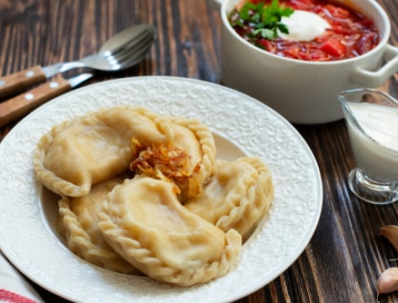
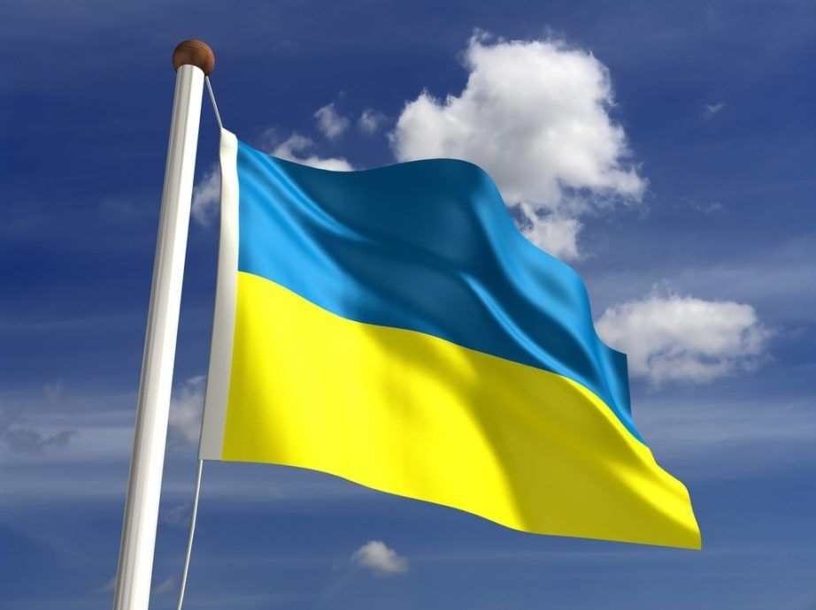
My Motherland, Ukraine
Hello, I’m Aleksandra from Ukraine. I want to tell you about my country. Ukraine is a big country in Eastern Europe. Our country borders Russia, Belarus, Poland, Slovakia, Hungary, Romania, and Moldova. 44 million people live in Ukraine. Our capital and largest city is Kyiv. Our Independence Day is August 24th. I’m wearing our national costume, the ‘vyshyvanka’. It’s very colorful! Our flag is blue and yellow. We eat beet soup called ‘borscht’ and potato dumplings called ‘varenyky’. Thank you for learning about my Motherland, Ukraine!

