Slide 1
Simon says

Slide 2
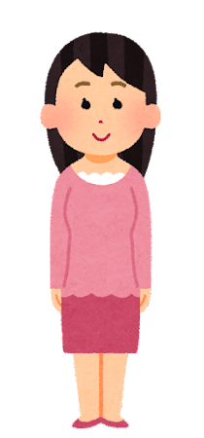
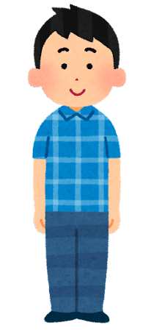
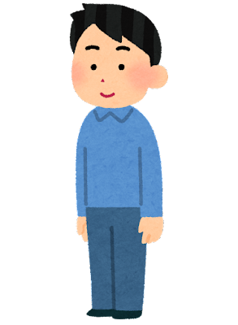
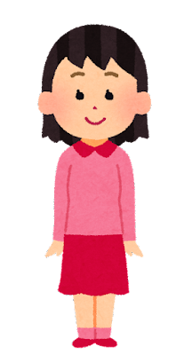
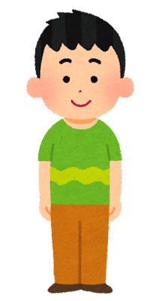
One person is "Simon"
Boss

Slide 3
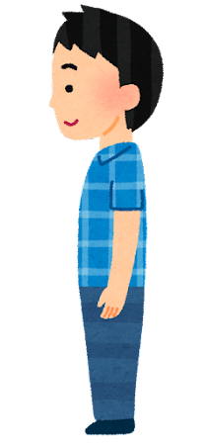
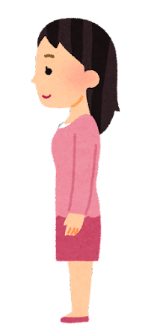
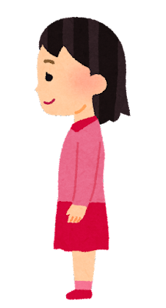
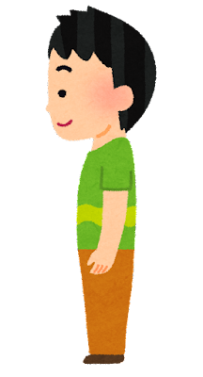
Simon says turn left.
Boss

Slide 4
Simon says turn right.
Boss

Slide 5
Simon says
Turn right
Boss

Slide 6
Simon say turn right.
Boss

Slide 7
Simon said turn left.
Simon says turn left.
Boss

Slide 8
Winner!
Boss

