Slide 1
Big
Small
Small
Smaller
Smallest
Big
Bigger
Biggest

Slide 2
Bigger
Big
The biggest

Slide 3
Small
Smaller
Smaller
The smallest

Slide 4
=
is as big as
big
=
is as small as
small

Slide 5
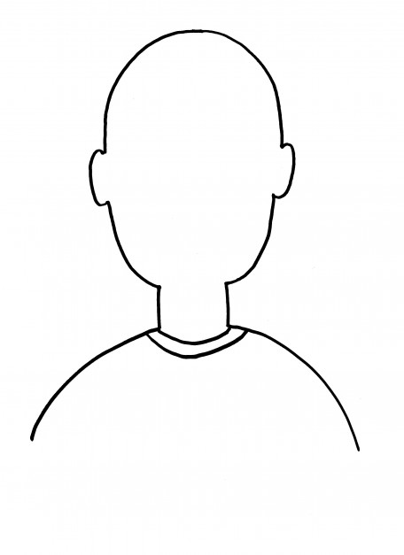
There are 3 people.
Vinny
JANE
GREG

Slide 6
① Vinny has a big nose.

Slide 7
② Greg has small eyes.

Slide 8
③ Vinny has bigger eyes than Greg.

Slide 9
④ Jane has bigger eyes than Vinny.

Slide 10
⑤ Greg has a normal mouth.

Slide 11
⑥ Jane has the longest hair of all three.

Slide 12
⑦ Vinny is wearing a hat with his name on it.

Slide 13
⑧ Greg has the biggest nose of all three.

Slide 14
⑨ Jane’s mouth is as big as Greg’s, and Vinny has the largest mouth of all three.

Slide 15
⑩ Jane has the smallest nose of all three.

Slide 16
⑪ Greg has interesting hair.

Slide 17
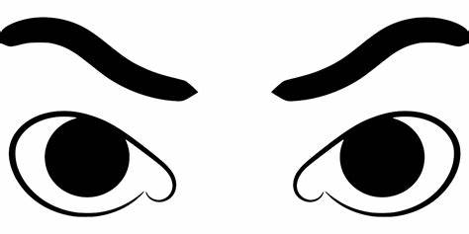
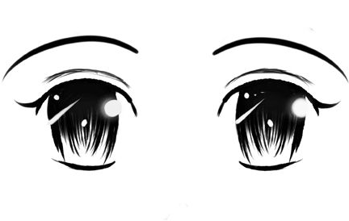
VINNY
Vinny
JANE
GREG
① Vinny has a big nose.
④ Jane has bigger eyes than Vinny.
② Greg has small eyes.
⑥ Jane has the longest hair of all three.
⑤ Greg has a normal mouth.
③ Vinny has bigger eyes than Greg.
⑨ Jane’s mouth is as big as Greg’s, and Vinny has the largest mouth of all three.
⑧ Greg has the biggest nose of all three.
⑦ Vinny is wearing a hat with his name on it.
⑩ Jane has the smallest nose of all three.
⑪ Greg has interesting hair.

Slide 18
More
Less

Slide 19
Most
Least

