Slide 1
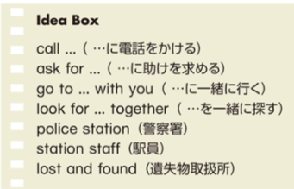
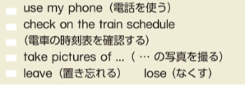
class: number: name:C c
Can I help you?：Talk 5
Can I help you?
いかがなさいましたか？
I have a problem.
私は問題があります
What’s the matter?
どうされましたか
I’m in trouble.
私は困っています
Do you need some help?
助けが必要ですか？
I appreciate it.
それは有り難いです。
Shall I ~~ ?
OOしましょうか？
Please make pairs. Every student will get a card with a problem on it. Student on the right please be A first, and student on the left please be B. Then switch who is A and who is B. When time is up, you will pass the cards forward so that you have new problems. Then, start again.
Can I help you? / What’s the matter? /
Do you need some help?
A
Yes! I have a problem. / I’m in trouble.
(カードの問題を読んでください。カードの問題を読んでください。)
B
Oh no! / I’m sorry.
Shall I (アイデアボックスを使い自分で考えて、問題の解決策を言いましょう) ?
A
Thanks. I appreciate it! / Thank you for your help!
B
Now, please write your own original skit with your partner!
A:___________________________________
B:___________________________________
A:___________________________________
B:___________________________________

