Slide 1
Unit 7 - Welcome to Japan
Communication Practice

Slide 2
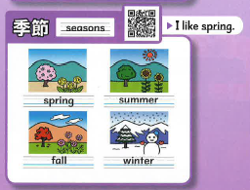
Step 1
What season do you like?
I like winter
I like ~.

Slide 3
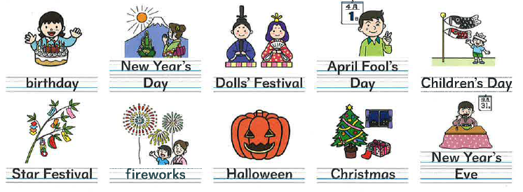
Step 2
Why do you like ~ ?
We have O O in ~.

Slide 4
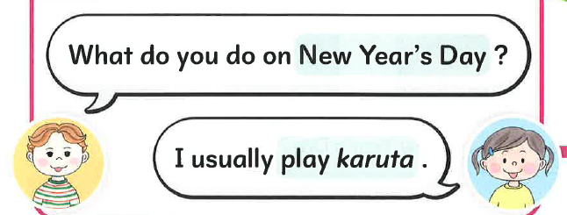
Step 3
What do you do on O O ?
I usually _______.
play go
eat throw
watch see
do make

Slide 5
Step 1
Step 2
What season do you like?
I like winter
Step 3

